Slide 1
Return on Investment (ROI) for Virtual environments and Gaming Carole Bagley, Ph.D. Technology Group, Inc. and U of St. Thomas

Slide 2
Topics
Importance of Effective Learning and Effectiveness of Virtual Environments, Games & Simulations
What is Return on Investment (ROI)?
Results of the evaluations conducted where games and virtual environments have been used that have shown effectiveness at 1 or more ROI Levels 1-5
Demonstrations of products
Participant discussions of ROI evaluations you have conducted when utilizing games and virtual environments for learning and the results

Slide 3
Importance of Effective Learning & Effectiveness of Virtual Environments, Games & Simulations
How many of you have created virtual environments and/or games for learning?
Do you believe that you have shown effectiveness for the learner & had an impact by improving a skill or knowledge and/or had an impact on their job/life?
Who believes virtual environments/games show greater learning effectiveness & impact on the job or life than instructor-led training or typical e-learning?
Who has conducted evaluations of virtual worlds and/or games to prove effectiveness?

Slide 4
ROI Evaluation Planning (Kirkpatrick/Phillips) Level 1 - Reaction: Did the learner like it? Is learner satisfied with the training? Level 2 - Learning: Pre-post test change. Did learner improve knowledge or skill? Level 3 - Transfer: Performance of learner on the job: knowledge, best work practices, & effective use of technology as it applies to my job/ life has improved. Success case stories of how the learner used the learning product to improve their work, increase productivity, gain a grade increase, get a new job, impress others, provide better service Level 4 - Business results: Impact on the Organization. Business results or performance measures improved as a result of improved job performance. Effect on productivity of the organization and organizational effectiveness. Due to this learning and the support I received, I will assist the organization in increasing its overall effectiveness by working better with co-workers, improve workflow, get more work done, improve quality of my work, have a positive effect on clients. Talk aloud verbal protocols would permit in-depth examination of the experience as each audience type works through the learning. Level 5 - ROI (Return on Investment) – impact and cost measures. Cost benefit to the organization.

Slide 5
Dentistry Level 2 results The game/test motivated the learner to focus on the best practice dental tasks described and simulated in the learning.
 | Pretest | Posttest | Avg score gain
Less than 3 months working as a Dentist, Dental assistant, or Hygienist | 58.2% | 93.9% | 35.7%
More than 3 months working in the field of Dentistry | 60.5% | 93.5% | 33.1%

Slide 6
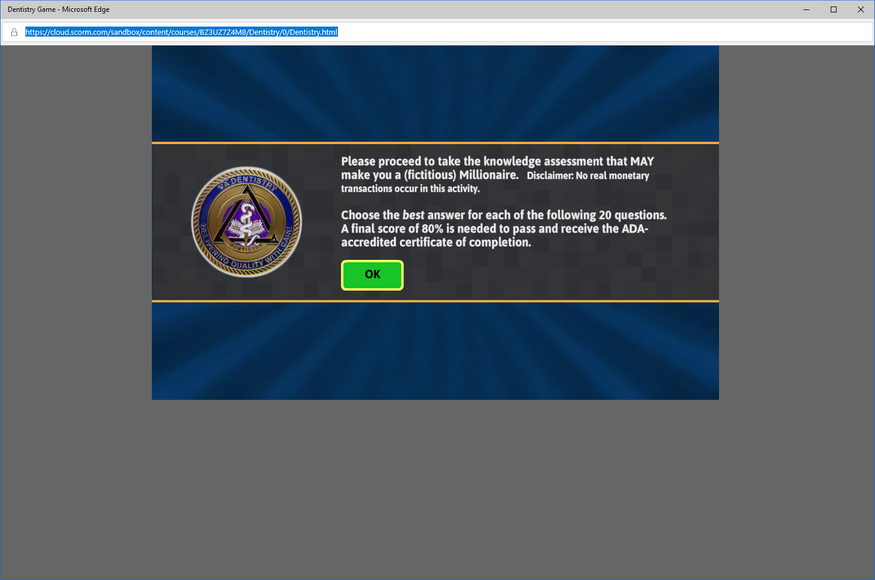

Slide 8
Pharmacy Technician blended program – DOD (ranking at level 1 2 3 4 5 with 5 being highest) Level 1 - Learners enjoy and receive a good experience with the learning. (5) - The quality of the WBT is viewed as high by learners, SME’s and supervisors. (5) Level 2 - Learners learn the content and their learning performance increases upon completion. (4) Level 3 - Pharmacy technicians are more productive and doing more work in less time on the job. (4) - The quality of learning matches job performance expectations of a pharmacy technician. (4) Level 4 - Training time has been reduced. (4) - The training provides learner and program flexibility as it can be used by new, in- experienced pharm-techs) or as refresher for experienced pharm-techs & pharmacists. (4) - The program assists in decreasing attrition rates on the job. (4) - Pharmacy technicians have a positive effect on the clients by providing better service. (4) Level 5 - The learning programs are shared with multiple agencies thus seeing lower costs in delivering the training.

Slide 9
Pharmacy Tech results
Level 2 Comparison
 | Pretest | Posttest | Avg score gain
Less than 6 months as a Pharmacy tech | 57.6 | 89.8 | 32.2
More than 6 months as a Pharmacy tech | 81.6 | 88.6 | 7.0

Slide 10
Health Benefits Advisors (HBA)
Expectations/Goals
Increase basic eligibility/enrollment knowledge and its application
Reduce the error rate and increase the quality of service provided by HBAs, thereby improving customer service
Enable HBAs to complete tasks with speed and efficiency in order to effectively meet the needs of all customers
Level 1. Reaction: Did the learner like it? Is the learner satisfied with the learning?
Level 2. Learning: Pre-post test change. Did the learner improve their knowledge or skill?
Cognitive – pre and post tests, did the learner improve their knowledge and/or skills?
Affective – Survey attitude change/skill or confidence building
Level 3. Transfer: Performance of learner on the job: knowledge, best work practices, and effective use of technology as it applies to their job has improved. Success case stories of how HBAs used their training to improve their work, increase productivity, gain a grade increase, get a new job, impress their clients/supervisor, provide better service
Success case evaluation
Clarify business goals, Administer survey, Analyze survey data to gauge scope of impact and identify success and no-success cases, Conduct success case interviews, Analyze impact and performance data, Articulate conclusions

Slide 11
Level 1 Satisfaction with the Learning Experience. This is assessed through the Posttest Survey that becomes available immediately after completing the corresponding module(s) Posttest. Scores in the excellent range (75 and above) for the HBA Certification Core and all the Specialty training modules.
Overall Satisfaction Scores after Completing the Web Based Training Module(s) with virtual environments, games, puzzles, simulations) | Description | Score
1‐12 | HBA Certification Core Training (including admission and enrollment) | 77.6
13 | Processing Appeals | 76.5
14 | Verifying Dental Eligibility | 79.6

Slide 12
Level 2 Learning: Pretest versus Posttest Score Gain
Level 2 measures the knowledge and skills learned by comparing Learner scores on the
Posttest taken immediately after completing the learning module(s) versus the
corresponding score on the Pretest taken before beginning the learning modules.
Test Score Gains by Experience as an HBA | Number of Learners | Test Score Average
 |  | Pretest | Posttest | Score Gain
Less than six months | 82 | 56.5 | 91.0 | 34.5
Six months or longer | 104 | 59.2 | 89.8 | 30.6
Overall | 186 | 58.0 | 90.4 | 32.4

Slide 13
Level 3 Transfer: Successful learning transfer to improve job performance
Dynamic learning is achieved through reinforcement, as Learners practice the
new knowledge, skills they have learned in their day to day execution of their
jobs. Level 3 gauges Learning Transfer both immediately after completion of the
learning and 3-6 months later.
Preparedness. Table 3.1 scores indicate that Learners felt Well Prepared for their
job after completing the WBT with games/simulations included. Follow Up surveys
(120 days after WBT completion) report a higher level of preparedness through
practice of knowledge & skills during day to day job execution.
Table 3.1 Overall Preparedness Score after Completing the Web Based Training Module(s) | Description | Score
1‐12 | Certification Core Modules | 76.7
13 | Processing Appeals | 68.4
14 | Verifying Dental Eligibility | 75.9
Learner use of knowledge, skills, and abilities gained on the job. This shows how the learning is being used. Follow Up Survey comments are gathered 120 days after WBT completion, augmented by interviews with a representative sample of HBA Learners. The HBA Learner feedback shows that WBT with games/virtual environment is an outstanding learning opportunity that was definitely needed to help meet the challenges of the HBA position.

Slide 14
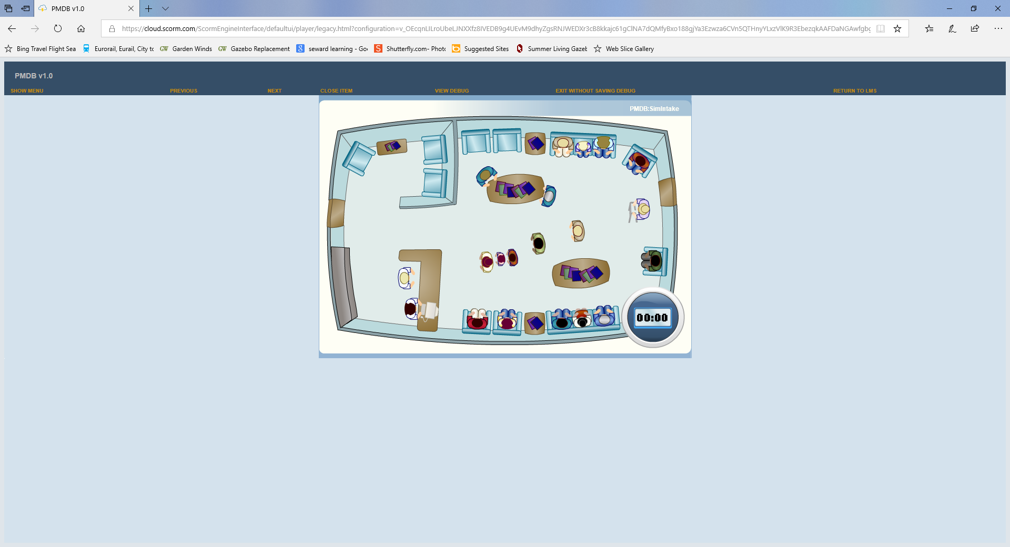

Slide 15
Dusty the Dragon - Tobacco Prevention (4th – 8th grade students)
Level 1: Separate/individual Conversations were held with 3 teachers and 2-4 students from each school separate from the large group and Attitudes/Reaction were positive and suggestions were expressed by each of these individuals.
Level 2: Compared overall Pre-test and Post-test for all schools/classes who did not use the game in Fall, 2018 to the same schools/classes who used the game in Spring, 2019. There is a statistical significant difference.
Overall, the increase from pre-to-post testing is positive and does indicate the benefit of
the game in reinforcing the adverse effect of tobacco and smoking.
Level 3: Affective results showed 99% state they will NEVER SMOKE or VAPE. 1% not sure.
School | % increase of mean from pre to posttest /no use of games | % increase of mean from pre to post test/use the games
Amery, WI | 5.4% increase | 15% increase
Laura Jeffrey ,MN | 8.5% increase | 17% increase
CVA, St. Paul, MN | 1% increase | 17% increase
St. Joseph, CO | .33% increase | 15% increase
Discovery, CO | 3.1% increase | 11.3%
Place Bridge, CO | 4.75% increase | 11%
St. Louis Park, MN | .73% increase | 16% increase

Slide 16
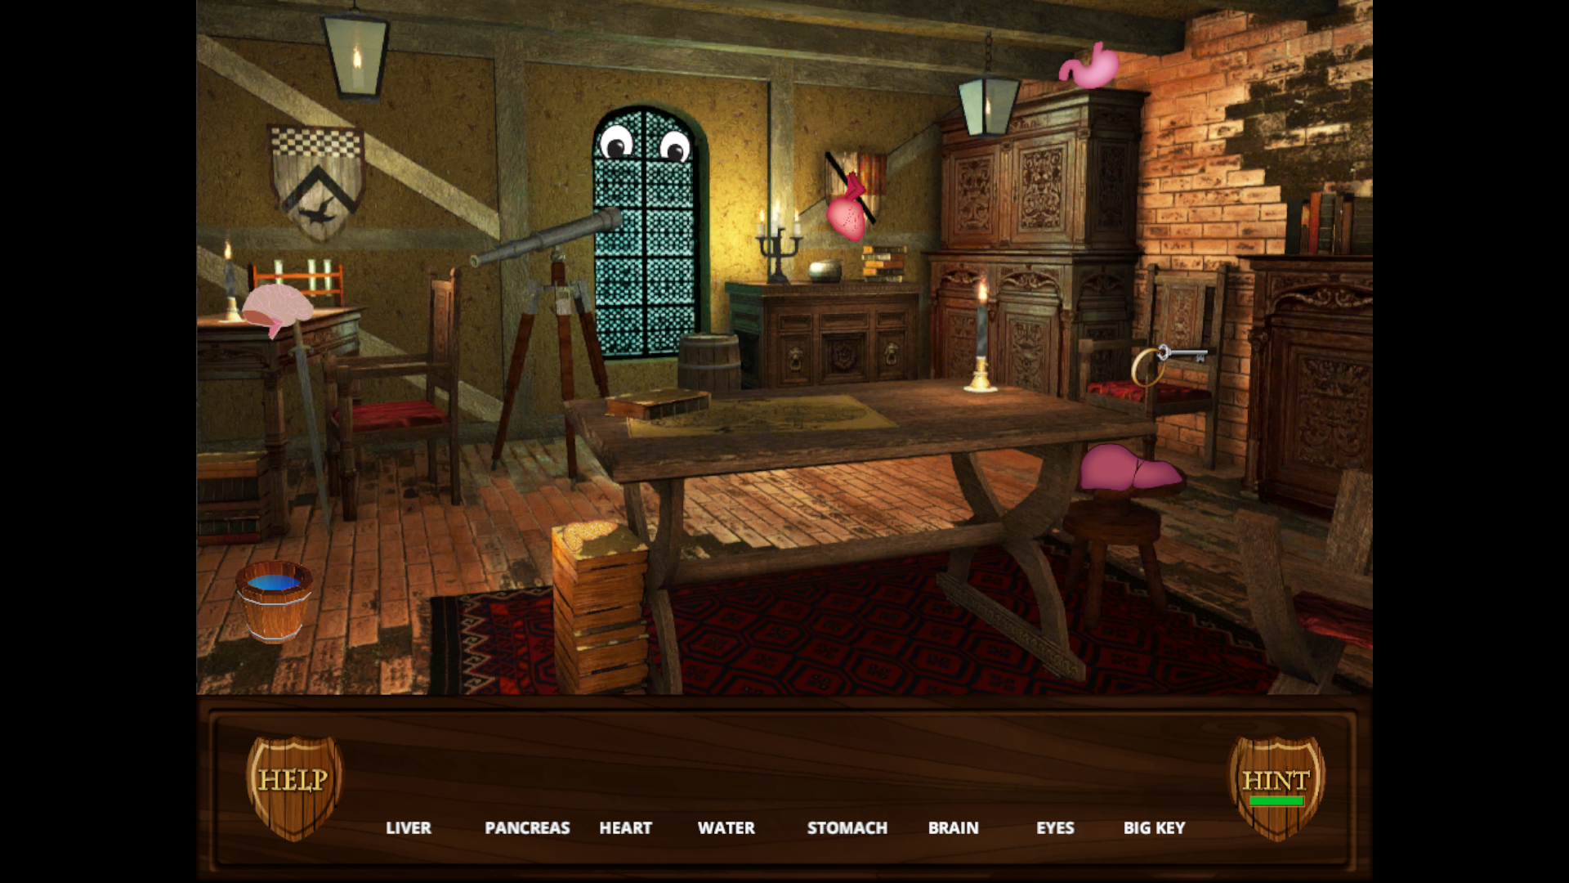

Slide 17
Demonstrations
Dentistry: How to be a Millionaire
Health Benefits Advisor (HBA): Simintake: Patient Intake/Enrollment
Tobacco Prevention: Dusty the Dragon

Slide 18
Participant Experience
Describe the educational purpose of your game, simulation or virtual environment.
Briefly describe your evaluation & the effectiveness of the results at ROI levels 1,2,3,4 or 5

