Slide 1
Disruptive Technology
Jothan Sargent
Robb Jacobs

Slide 2
What is your definition of disruptive technology? What does it mean to you?

Slide 3
One possible definition
“A disruptive technology is one that displaces an established technology and shakes up the industry or a ground-breaking product that creates a completely new industry.”
- Source: https://whatis.techtarget.com/definition/disruptive-technology

Slide 4
What are some examples of disruptive technology?

Slide 5
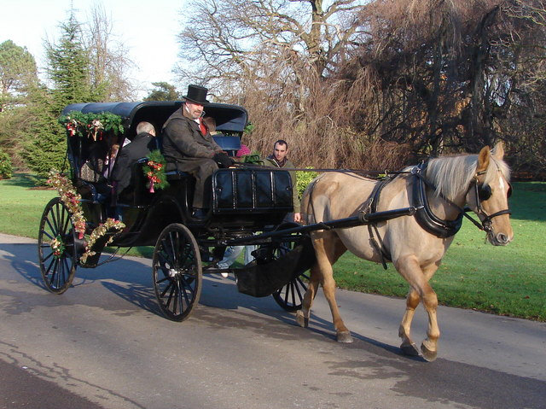
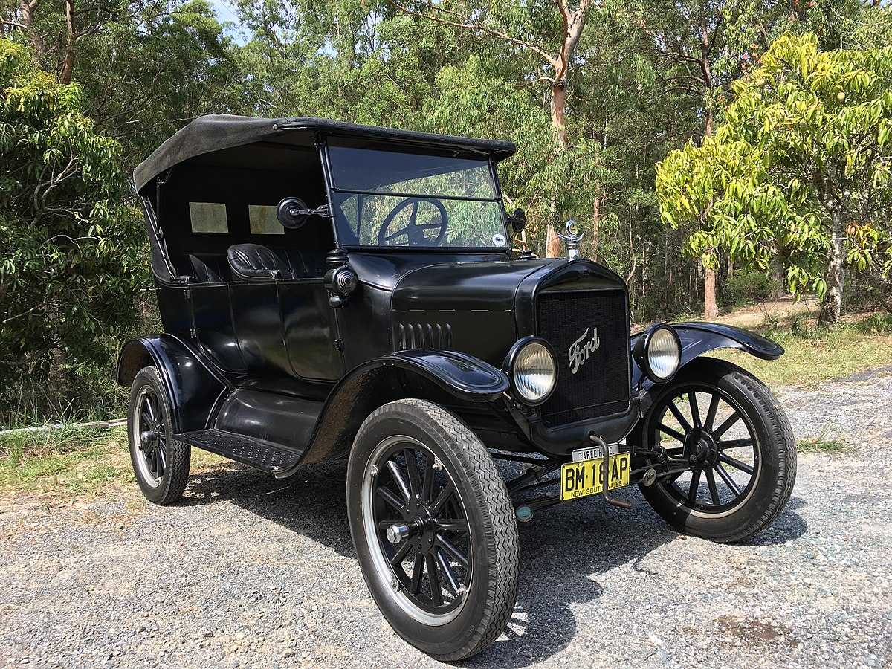
One example of a
disruptive technology
Ford Model T
Horse and buggy

Slide 6
New technology can introduce problems
New technology definitely has benefits, but there can be some negative aspects.
Example: https://youtu.be/qr7kRYO29n4?t=318 (Watch what happens around 5:55)
In this example, we identified the need for traffic laws.

Slide 7
New technology can introduce problems
What are the social impacts of smart phones, social media?

Slide 8
New technology can introduce problems
With the advent of smart phones and social media we are seeing some very specific problems.
New forms of addiction: smart phone, social media (e.g. Facebook).
Some people report a great deal of anxiety when they don’t have immediate access to their smart phone.
Test: Try to take away a smart phone from a teenager for an hour and have them report how they feel.

Slide 9
New technology can introduce problems
Challenges are caused by not having enough time to absorb the new technology.
The technology develops faster than people can keep up (runaway technology).

Slide 10
How can we use training to help?
How can we use training to help people not get hurt by technology, to mitigate the negative aspects?
Introducing "Screen Safe", a Rivertown Communications e-Learning program designed to educate responsible adults on the dangers unsupervised social media use can be to today's youth.

Slide 11
Screen Safe
Screen Safe is a collaboration between Rivertown Communications and several other contributors including:
Jeff Olson - Instructional design
Jessica Wong - Hazelden Betty Ford
Julie Hertzog - National Bullying Prevention Center/PACER Center
Julie Jacobs - Frontier Fellowship/Rivertown Christian Ministries Int'l
Vijay Dixit - Shreye Dixit Foundation (preventing distracted driving)

Slide 12
Screen Safe
Why:
Personal stories
Evident need through seminar response
Internet research
Demo Program
Link to Screen Safe:
http://rivertown-lab.com/testing/ScreenSafe2/story_html5.html

Slide 13
Questions? Comments?
Any questions?
Contact Jothan Sargent at: jothan@rivertown-inc.com
Contact Robb Jacobs at: robb@rivertown-inc.com

