Slide 1
Digital Learning Forum Meeting November 12, 2018

Slide 2
Scenario #1
Your internal client, Marketing, are almost ready to launch their new CRM Software Tool, Relationships. Currently, end users use the CRM Software Tool, Force. They want training in place to train:
VPs of Sales
District Managers
Sales Associates
They are looking for instructor-led training that allows their audience to practice. They want the training to be led by one of the Marketing Team Members but have no idea where to start.
How do you solve this without instructional design?

Slide 3
Digital Learning Forum
Instructions:
Listen to Scenario 1.
In small groups, discuss any potential problems.
Discuss what you would DO if you encountered this situation.
Discuss whether Instructional Design is an important part of your solution.
Share your thoughts.

Slide 4
Scenario #2
A self-paced eLearning course on Information Barriers (an investment course) needs re-design.
There are two versions: an introductory online course that introduces new team members to policies and procedures for following proper investment processes and procedures when dealing with customer and personal investment information.
After team members have violated these guidelines and committed 3 or more “errors”, they receive re-fresher training on this same content-with added information and ‘warnings’.
The current Presenter course file is unavailable—but the SME has provided screen grabs of each screen of the course in the LMS. The current course is text based.
Is instructional design needed?

Slide 5
Digital Learning Forum
Instructions:
Listen Scenario 2.
In small groups, discuss any potential problems.
Discuss what you would DO if you encountered this situation.
Discuss whether Instructional Design is an important part of your solution.
Share your thoughts.

Slide 6
Scenario #3
A quarterly newsletter is sent out to employees to update them on company and line of business policy changes.
Team members must demonstrate they have read the newsletter updates by taking and passing a 10 question assessment posted in the learning center.
Is instructional design needed?

Slide 7
Digital Learning Forum
Instructions:
Listen to Scenario 3.
In small groups, discuss any potential problems.
Discuss what you would DO if you encountered this situation.
Discuss whether Instructional Design is an important part of your solution.
Share your thoughts.

Slide 8
Scenario #4
A local company has decided to abandon several smaller systems and migrate to a common ERP system (PeopleSoft). As a result, data needs to be shared by approximately 150 users.
Is instructional design needed?

Slide 9
Digital Learning Forum
Instructions:
Listen to Scenario 4
In small groups, discuss any potential problems.
Discuss what you would DO if you encountered this situation.
Discuss whether Instructional Design is an important part of your solution.
Share your thoughts.

Slide 10
Scenario #5
A large medical device manufacturer updated several processes which impact hundreds of engineers. For simplicity, the senior director recommended that the updated procedures be distributed to everyone as a “read and acknowledge” package through the LMS. However, if the new processes are not followed, it could potentially lead to an audit finding.
Is instructional design needed?

Slide 11
Digital Learning Forum
Instructions:
Listen to Scenario 5.
In small groups, discuss any potential problems.
Discuss what you would DO if you encountered this situation.
Discuss whether Instructional Design is an important part of your solution.
Share your thoughts.

Slide 12
Scenario #6
The director of a small manufacturing facility recommends quality control training for the staff. He feels they can become more competitive by moving toward ISO-9001. Since this team is working in a manufacturing area, they don’t have desks, but they do have phones. The director wants this to be a mobile solution and suggests just pulling together existing material from the Internet.

Slide 13
Digital Learning Forum
Instructions:
Listen to Scenario 6.
In small groups, discuss any potential problems.
Discuss what you would DO if you encountered this situation.
Discuss whether Instructional Design is an important part of your solution.
Share your thoughts.

Slide 14
Scenario #7
The call center of a U.S. based retail operation is relocating from India to South America. The call center in India had older technology, and low customer satisfaction ratings based on the customer surveys. This South American call center has newer technology and more staff, so the company executives believe this will help improve customer satisfaction. They also want a call center with a time zone more closely aligned with their corporate office. They plan to convert their existing training materials to Spanish and use them as is.

Slide 15
Digital Learning Forum
Instructions:
Listen to Scenario 7.
In small groups, discuss any potential problems.
Discuss what you would DO if you encountered this situation.
Discuss whether Instructional Design is an important part of your solution.
Share your thoughts.

Slide 16
Scenario #8
Some scientists in Minnesota just developed a new chemical cleaning product that will be manufactured at factories in Brazil and France. Engineers and operators must be trained on:
Reasons for the new product to be produced
Storage and handling of hazardous chemicals
Operations of brand new equipment for their factory
Timeline for new product to start production
Both job roles must receive the training.
The scientists want to develop and conduct the training on their own.

Slide 17
Digital Learning Forum
Instructions:
Listen to Scenario 8.
In small groups, discuss any potential problems.
Discuss what you would DO if you encountered this situation.
Discuss whether Instructional Design is an important part of your solution.
Share your thoughts.

Slide 18
Scenario #9
A group of IT developers are ready to deploy their sales tracking software to a team of sales reps. They have been working on it for two years. The sales reps will be using this new software to track and monitor their sales targets
Customers must also use the software to re-order their products online, rather than calling the sales rep. They need training as well
The IT developers and sales team have had very little contact with each other throughout the development process, but the project manager used to be on the sales team before moving to the IT team
Since the PM used to work in sales, he wants to develop and conduct the training on his own

Slide 19
Digital Learning Forum
Instructions:
Listen to Scenario 9.
In small groups, discuss any potential problems.
Discuss what you would DO if you encountered this situation.
Discuss whether Instructional Design is an important part of your solution.
Share your thoughts.

Slide 20
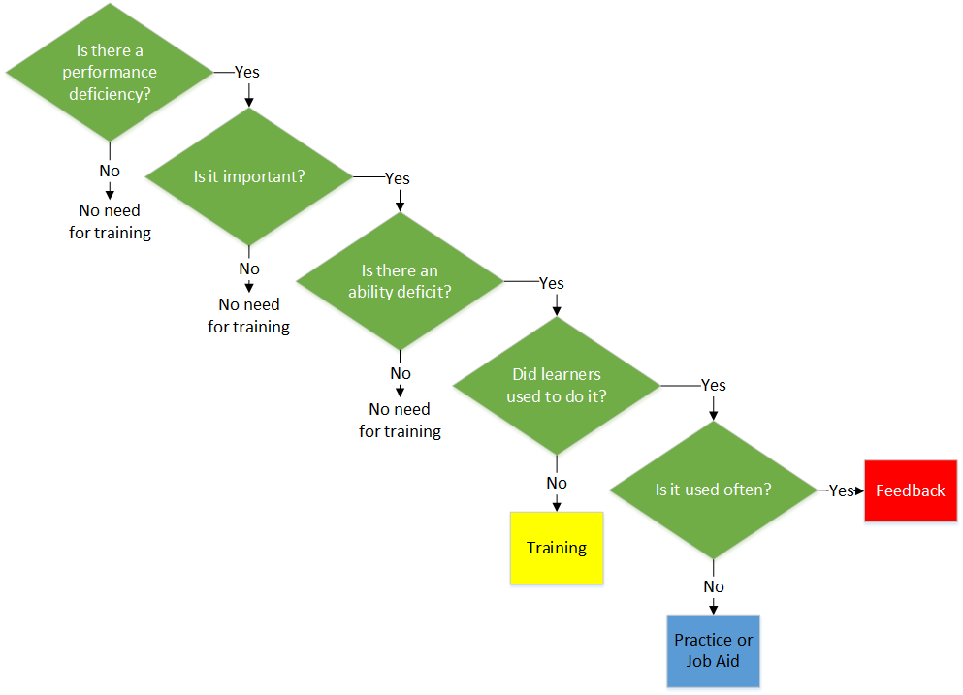
Is it even a Training Need?
Notes:
Source: Allen Interactions webinar 10-10

Slide 21
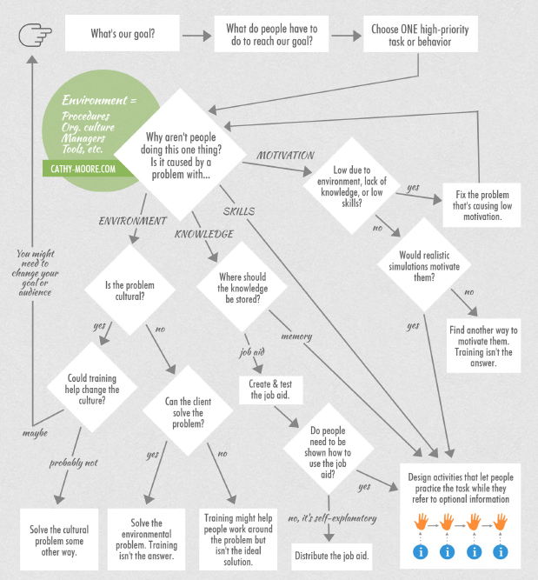
Will Training Help?
http://blog.cathy-moore.com/2013/05/is-training-really-the-answer-ask-the-flowchart/?doing_wp_cron=1541799514.0466148853302001953125
Notes:
Source: Cathy Moore

