Slide 1
Digital Learning Forum October 9, 2017
Academic Tools and Trends
Bob Andersen
Saint Mary’s University of Minnesota
Director, Instructional Technology-SGPP
rganders@smumn.edu

Slide 2
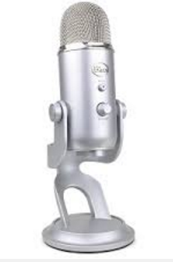
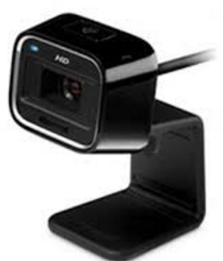
Selecting Tools that Work
Edtech

Slide 3
Three Forms of Interaction
In a widely cited editorial in the American Journal of Distance Education, Dr. Michael Moore observes three forms of interaction in distance education: learner-instructor interaction, learner-learner interaction and learner-content interaction.
Promote Human Interaction
Learner to Instructor
Learner to Learner
Promote Learner Interaction with Content
Three Forms of Interaction http://aris.teluq.uquebec.ca/portals/598/t3_moore1989.pdf

Slide 4
LMS Interaction Tools
Discussion Forums
Groups
Announcements
Wall in Engage
Collaboration Tools
Google Docs
Wiki
Whiteboard: Padlet
Meeting Tools
Go To Meeting
Zoom
Google Hangouts
LMS Grading Tools
Gradebook
Crocodoc
Rubrics
Promote Human Interaction
Student to Student
Student to Instructor
Interactive Presentation Tools
Mentimeter
Google Slides
Poll Everywhere
Turning Point
Video Interaction
VoiceThread
FlipGrid
ED Puzzle
Ted ED
Record Video/Screen
Capture Cast
Screencast-o-Matic
QuickTime
Smartphone

Slide 5
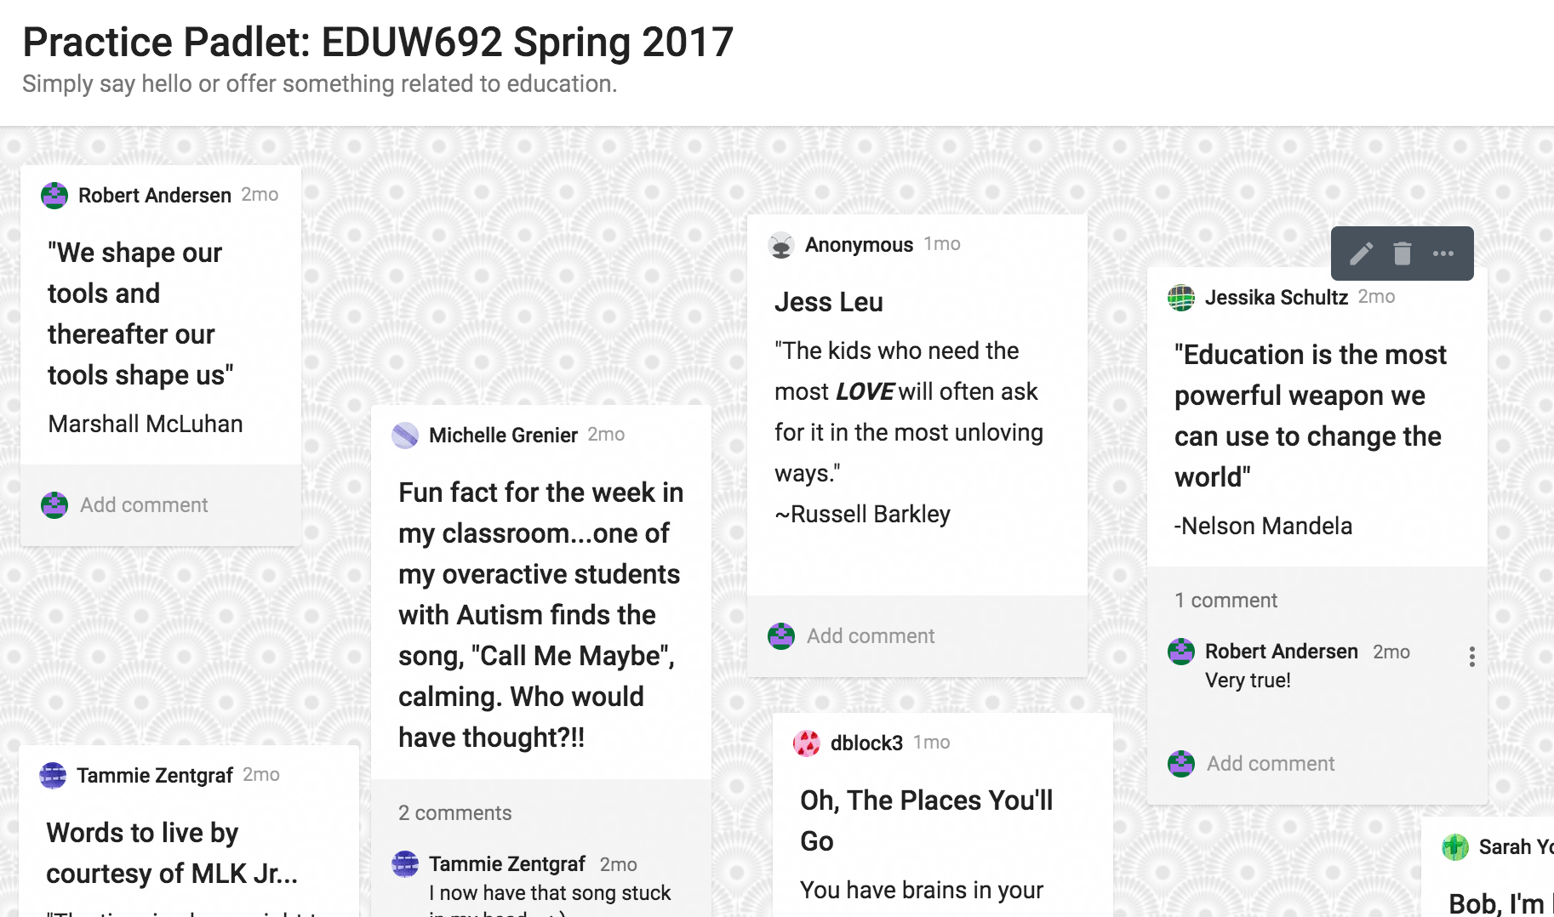

Slide 6
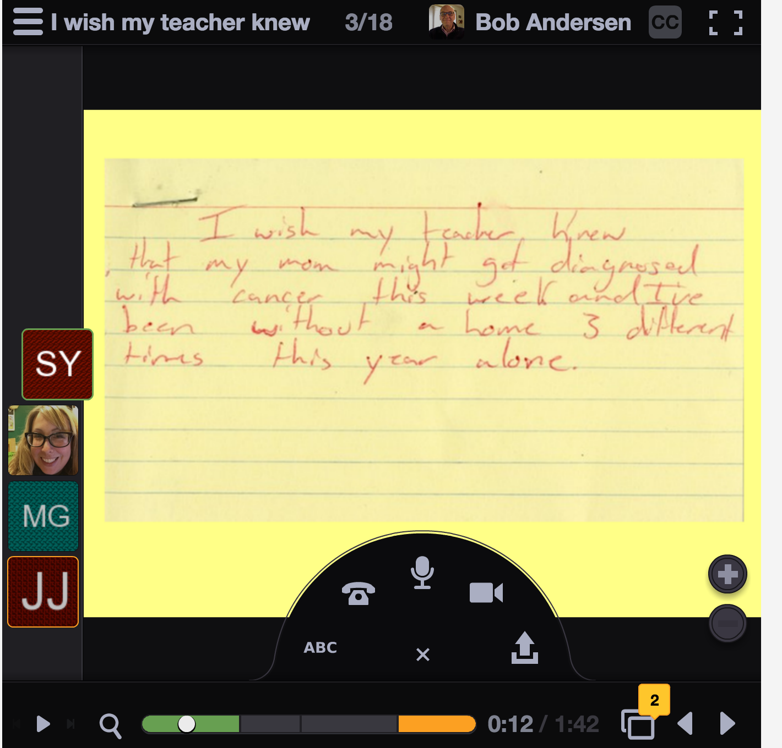
Tools that Facilitate Interactions - Voicethread
100 People
Project

Slide 7
Tools that Facilitate Interactions

Slide 8
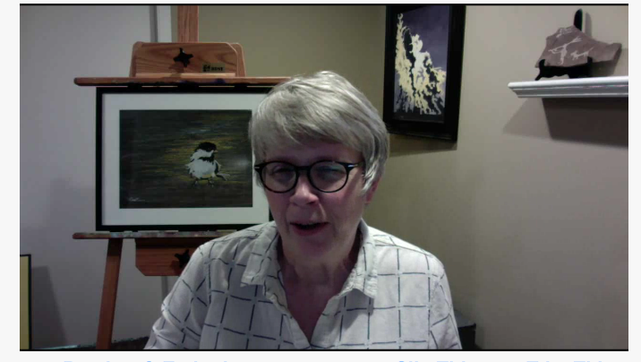
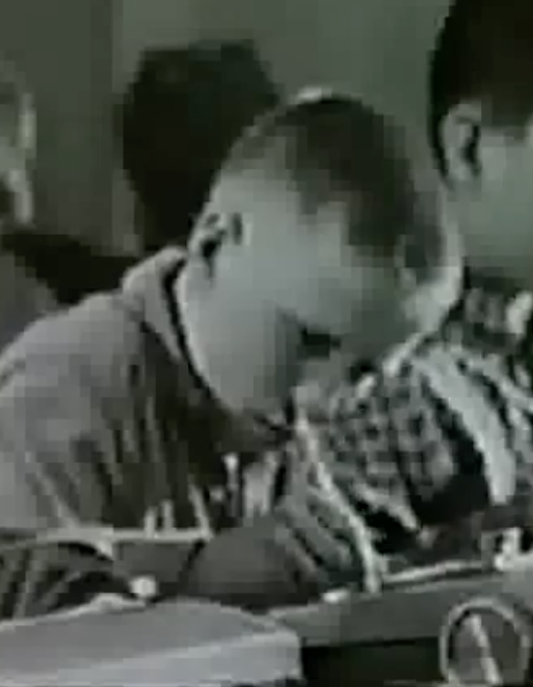
EDPuzzle
Capture Cast

Slide 9
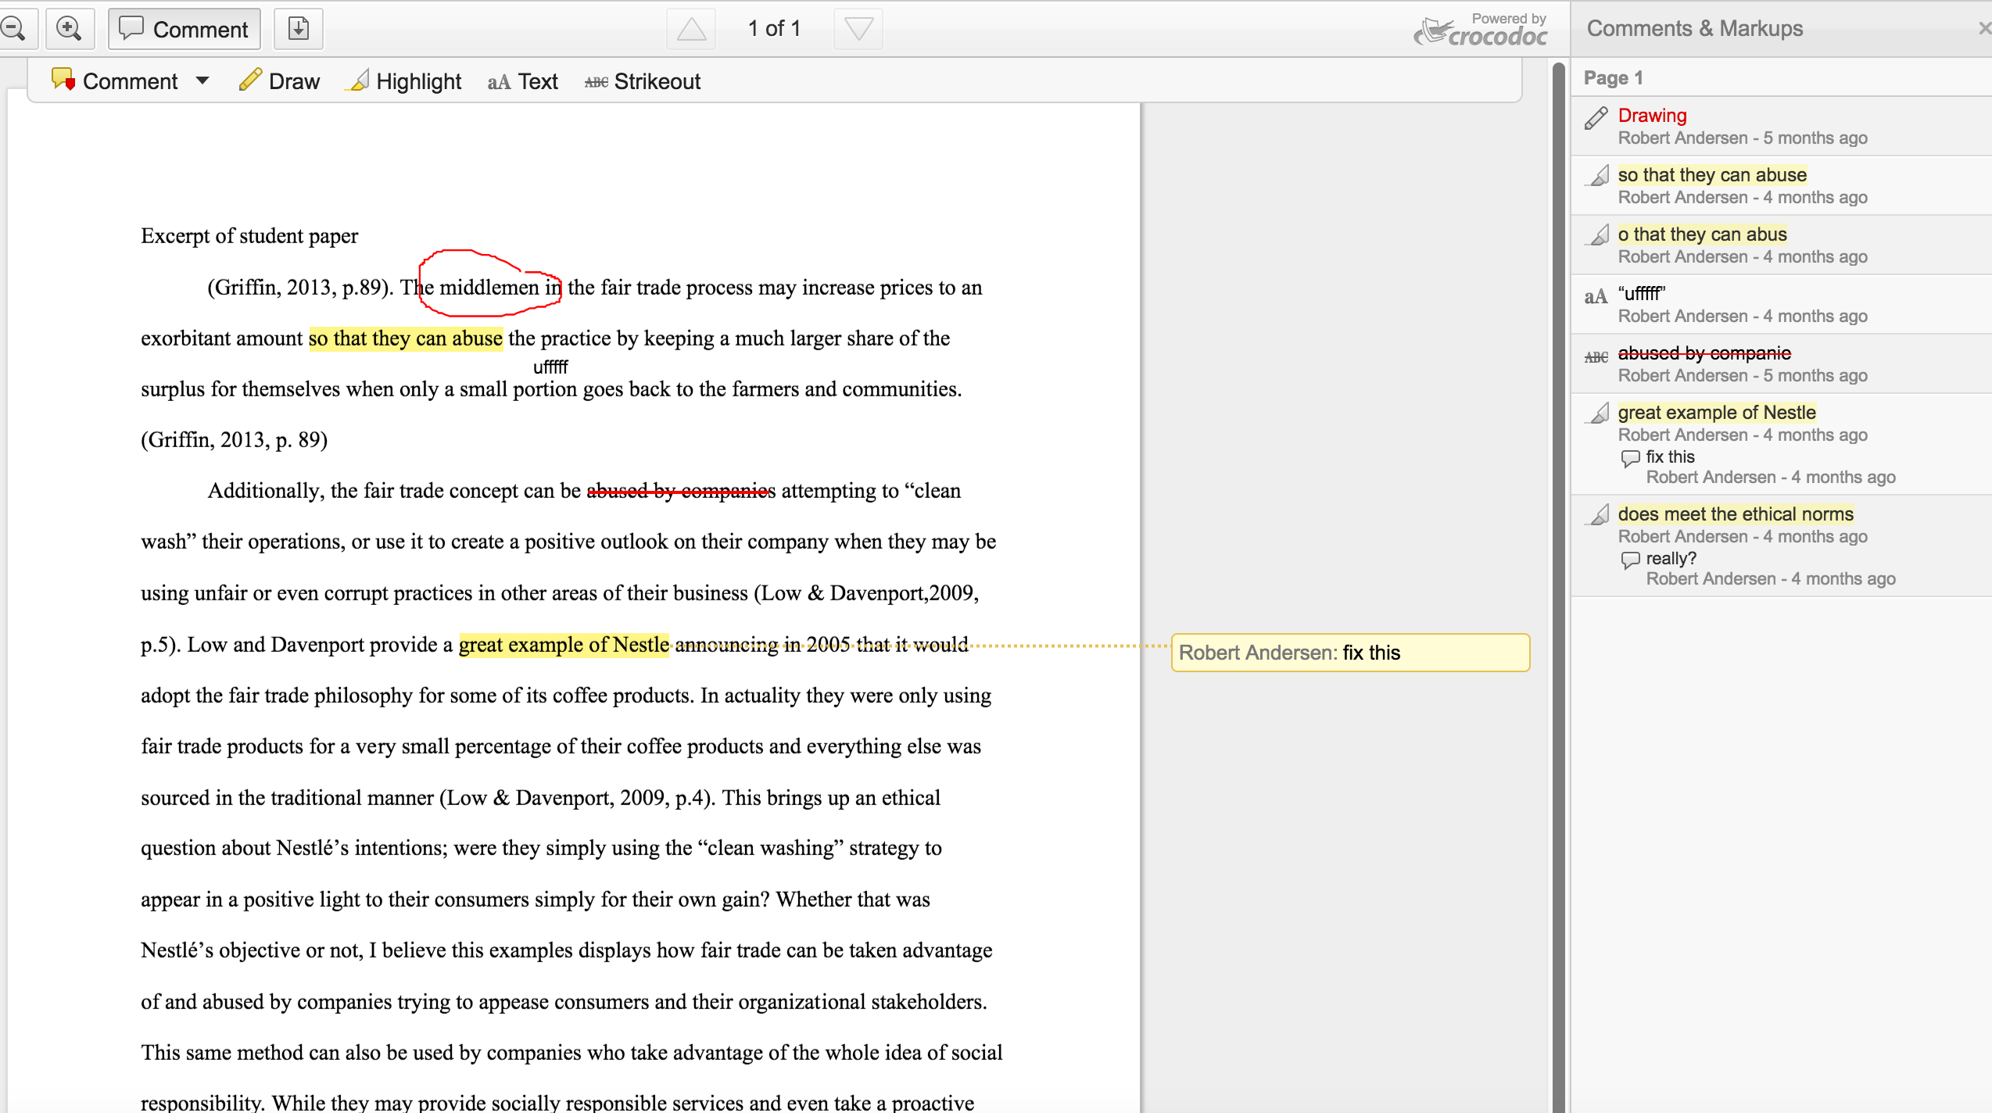
Crocodoc

Slide 10
Visualize Data
Lucidchart
Infographic
Tableau
MS Excel
Survey/Collect Data
Google Forms
Clickers
Survey Monkey
Concept Mapping
Diigo
Mindmeister
Reflection Tools
Blogs
Journals
E-portfolios
Create/Curate/Remix
Wiki
Website (Google Sites)
Infographic
Animation
FlipBoard
Promote Student Interaction with Content
Instruct/Present
Narrate PowerPoint
Google Slides
Prezi
VoiceThread
Video
Screencast
Podcast
Explain Everything
Games
Kahoot
Clickers
Simulation Tools
CapSim
Author/Publish
Twitter
Website
Blog

Slide 11
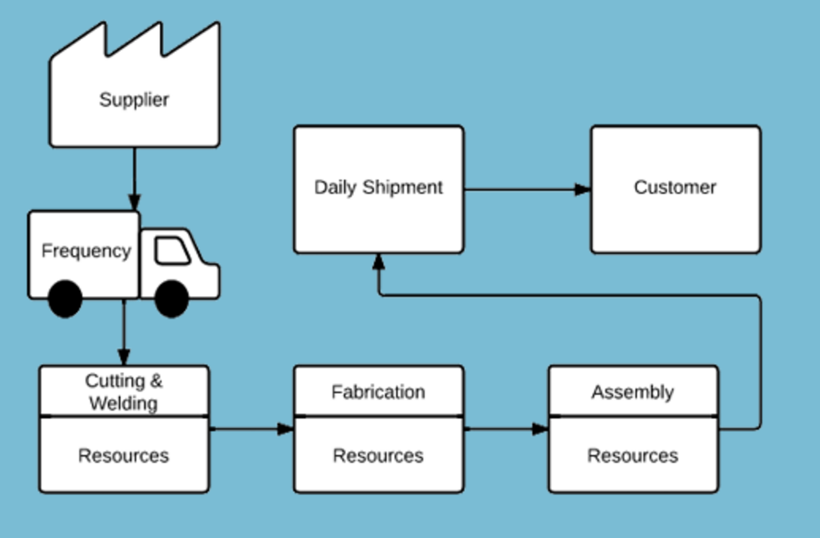
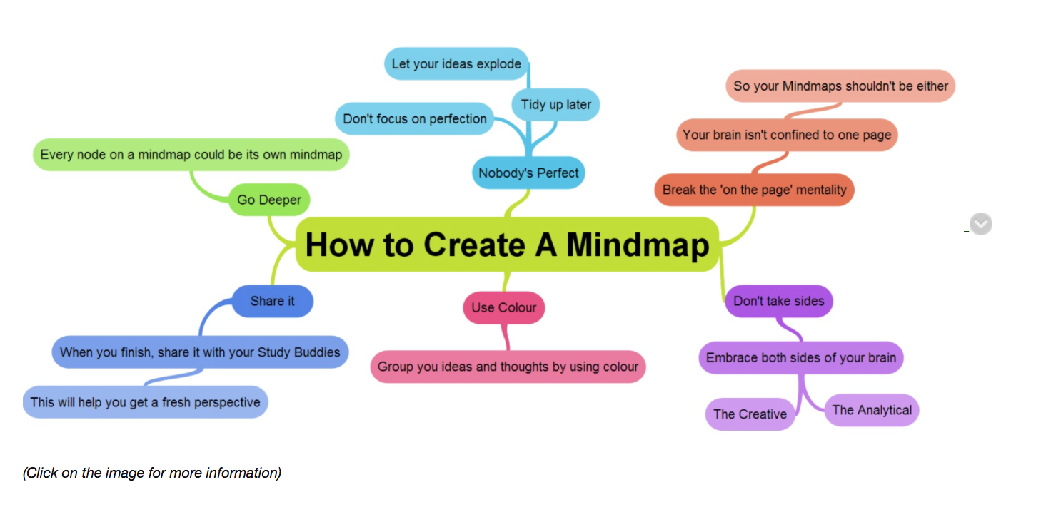
Examples of Technologies that Facilitate Student Learning
Lucidchart
Pictochart

Slide 12
Other Ed Tech Tools Perspectives Considered
Assess Student Learning
Direct Instruction
Promote Human Interaction
Student to Student
Student to Instructor
Promote Student Interaction with Content
Improve digital skills and workplace readiness
Improve instructor productivity

Slide 13
Selecting Instructional Technologies: What I’ve Learned
It’s not about the technology; it’s about the learning
Keep it simple
Selecting instructional technologies is not formulaic
Purposeful and intentional
Notes:
Examples really help

