Slide 1
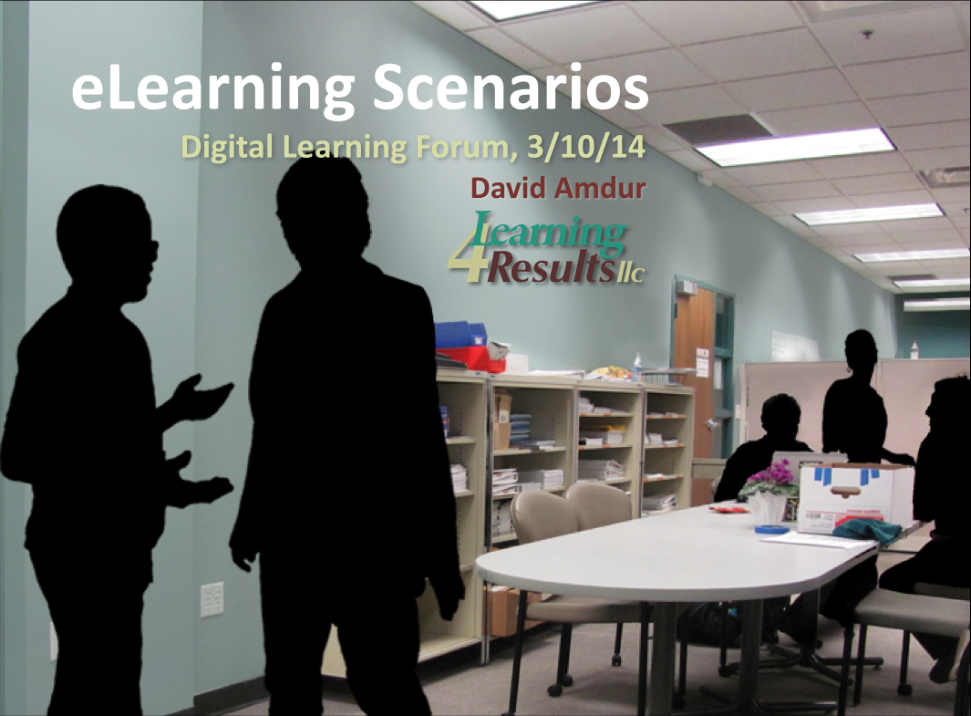
Notes:
Advantages of scenarios-based learning
and aspects of design.
I’ll be showing 4 examples I designed, and look at others designed by others.
But let’s start off with a story…

Slide 2
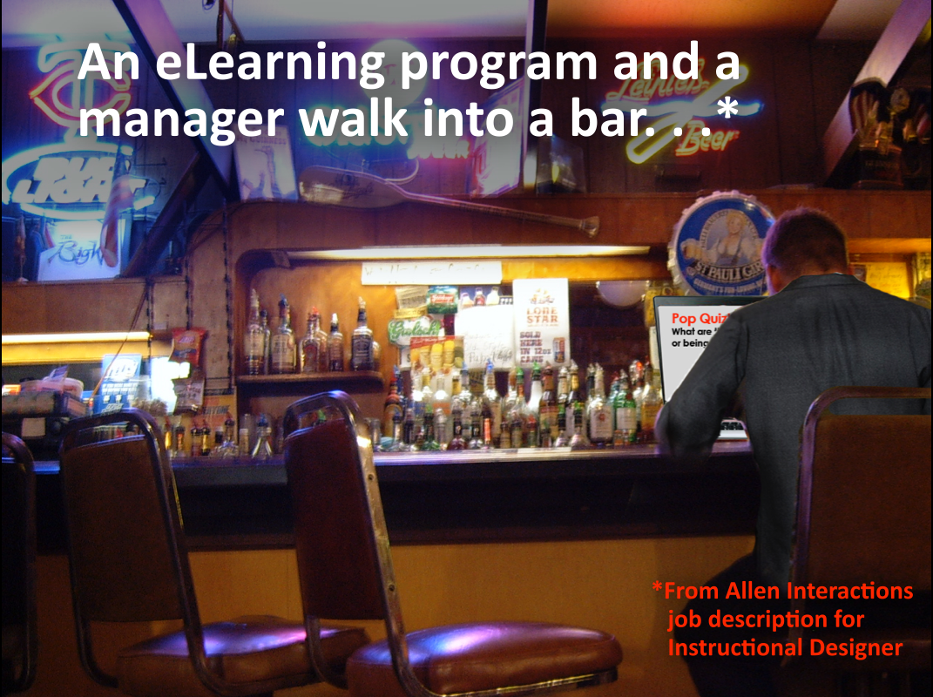
Notes:
I cribbed this joke is taken from job description for Instructional Designer posted by Allen Interactions.

Slide 3
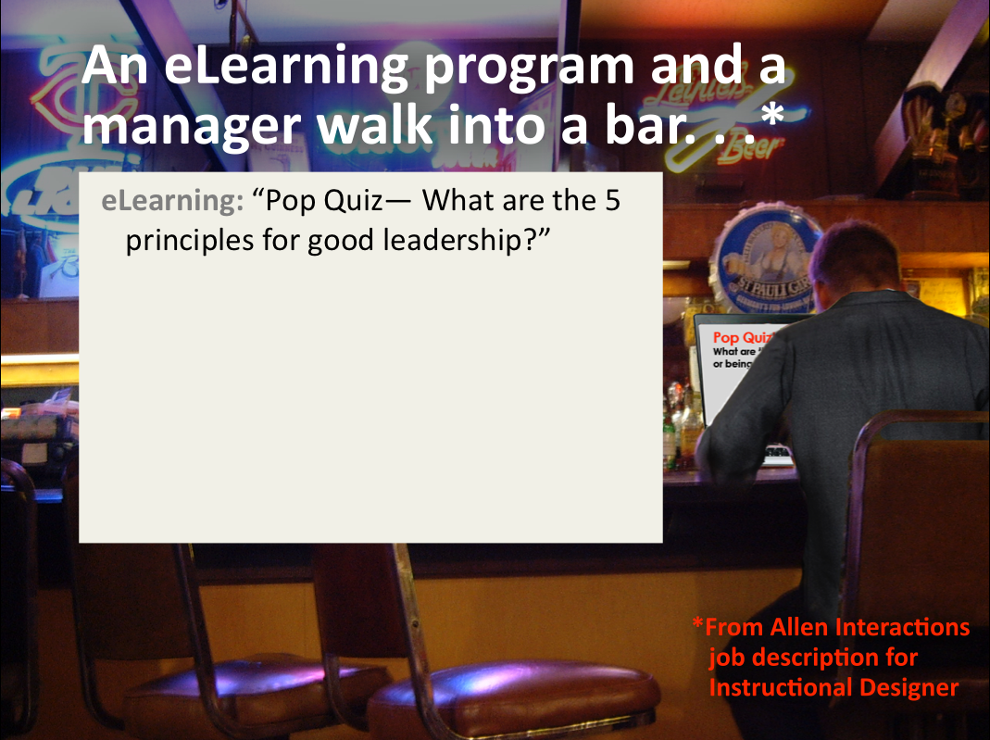
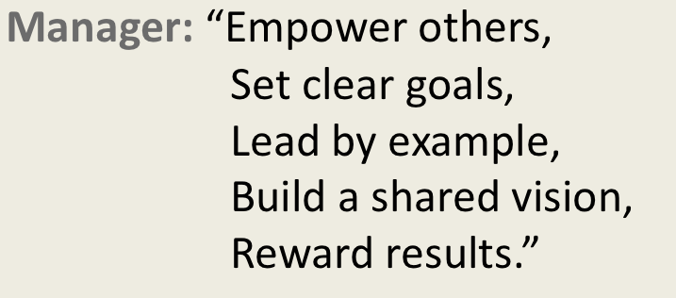


Slide 4
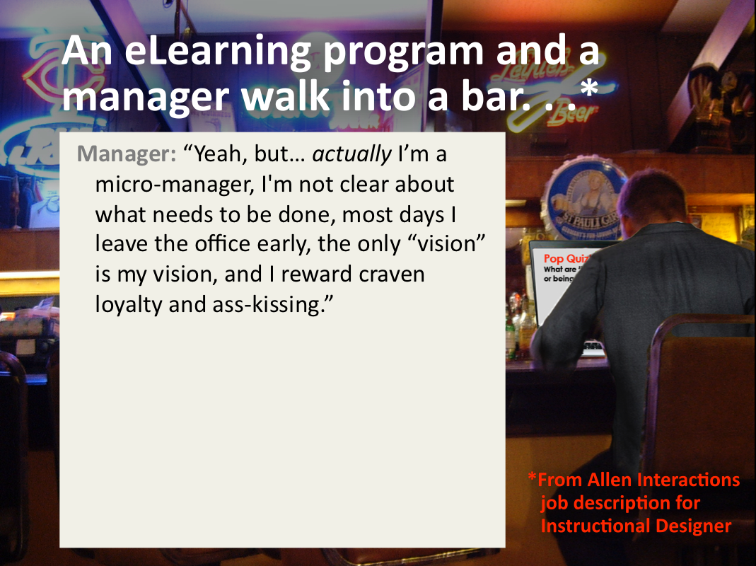
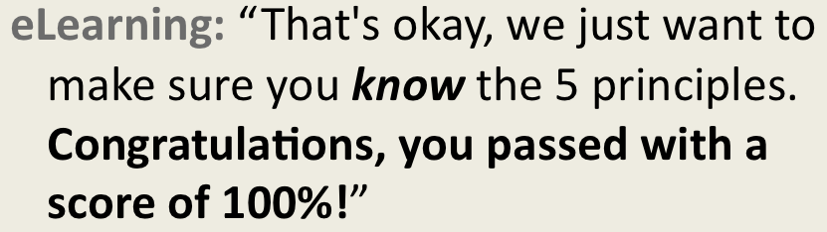

Notes:
A particular view of ‘education’ focuses on recall, instead of actual performance.
This points to a gap between knowing and doing.

Slide 5
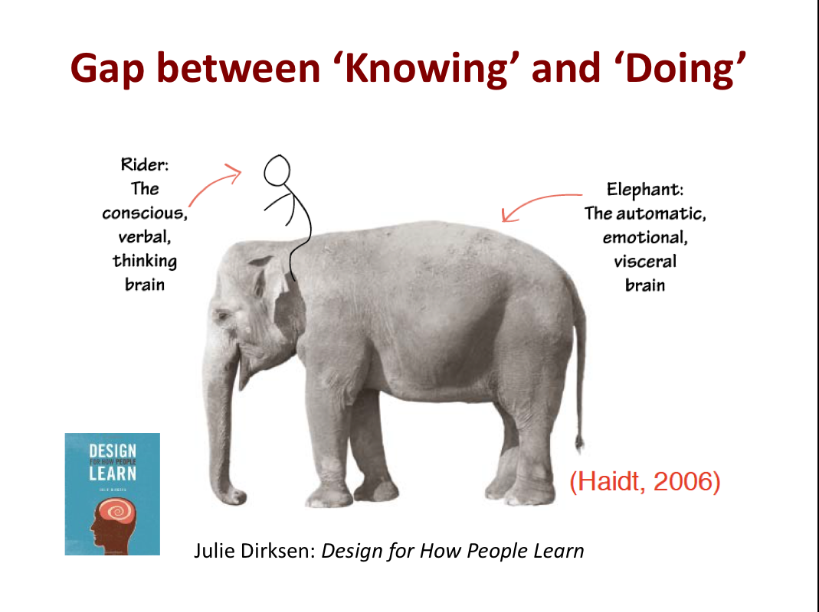
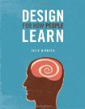
Muchos
palabras!
?
Julie Dirksen: Design for How People Learn
Notes:
In her book, Design for How People Learn, Julie Dirksen borrowed from Jonathan Haidt to illustrate the gap between conscious knowledge and unconscious habitual behavior.
Our conscious mind can recount lessons,
but the elephant is a creature of habit—
it needs to be trained to follow a new path.
X
Spanish: Know many more words than I can use in conversation.
Software: Can read how it works, understand it, but still get bogged down when first trying to use it.
Practice is needed to transfer learning to application.

Slide 6
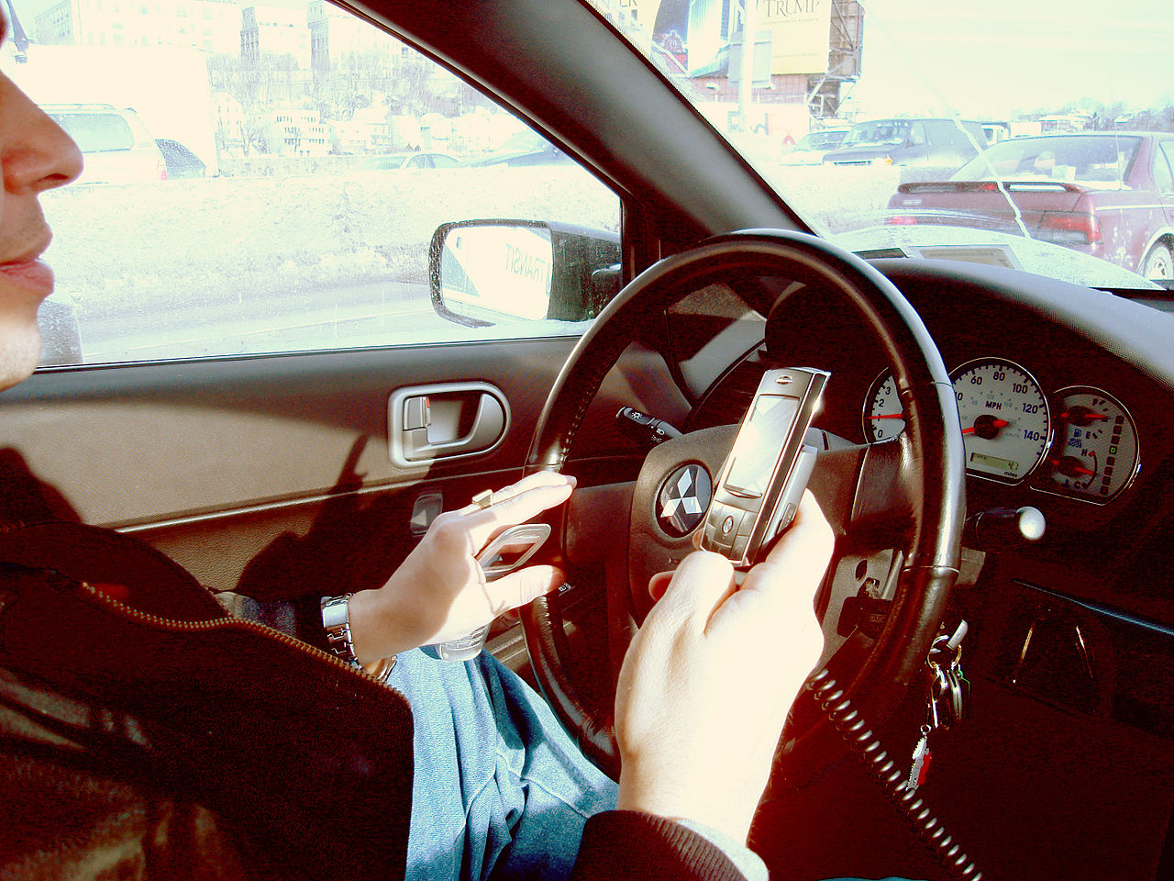
Notes:
Then there’s things that everyone knows they shouldn’t do, but do anyhow…
X
[because they haven’t personally experienced bad consequences.]

Slide 7
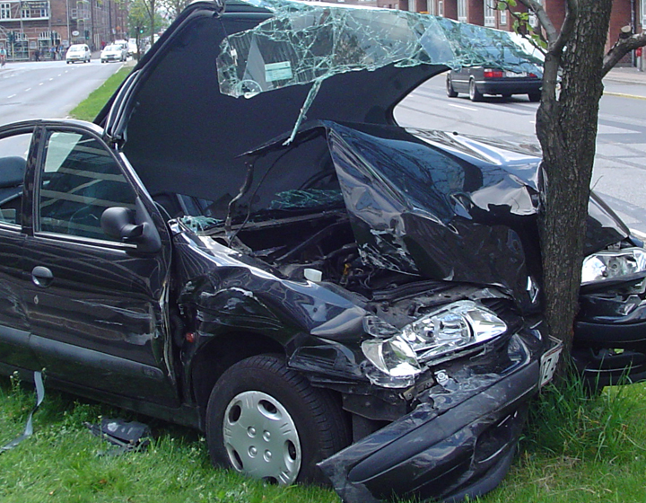
Notes:
… because they haven’t personally experienced bad consequences.
Giving learners a safe way to experience failure can save pain & expense.

Slide 8
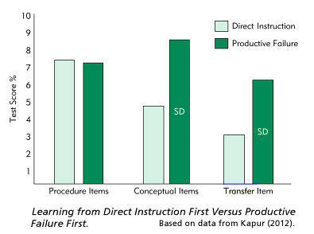

Productive Failure:
Ruth Clark: Scenario-based e-Learning
Notes:
This study sited by Ruth Clark indicates that learning through productive failure has cognitive advantages.
One group was taught a solution a statistics problem through direct instruction, while the other group was first asked to figure it out for themselves, before being given instruction.

Slide 9
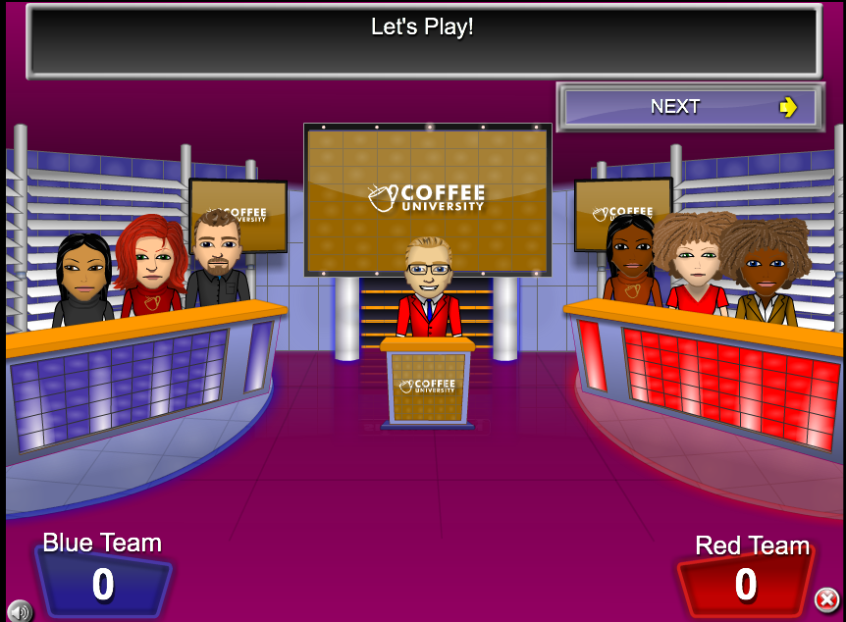
Notes:
This is from alearning game by C3 Softworks based on a TV game show.
Such games are superior to basic ‘tell and test’ elearning because they challenge learners to think about answers, before they are provided to them.
But I submit that transfer of learning from from the module to the job is better if the context resembles the work situation where the learning will be applied.
(A couple months back Linda Lysdahl showed example she created that were exceptionally well executed.)

Slide 10
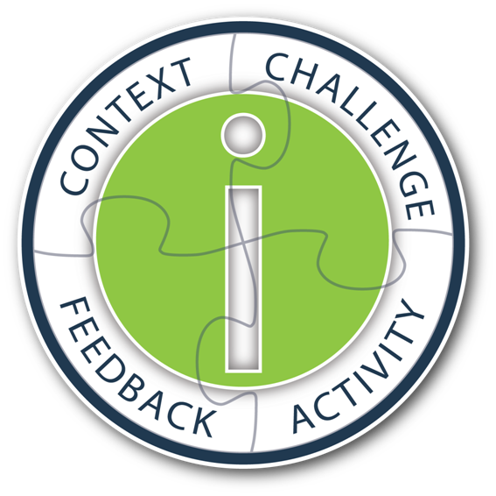
Allen Interaction’s model:
Notes:
Context should mirror the work situation.
Learner should be engaged by a meaningful challenge.
The learner responds with an activity—usually making a choice.
Feedback is best when it makes the learner reflect on the consequences of their decisions.

Slide 11
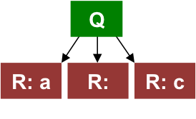
R: b
Most interactions are m/c.
Notes:
Most interactions are m/c: Column matching, drag & drop, etc.
Learner is given some limited number of choices.
Sometimes T/F, sometimes more, 3 choices is generally the minimum.

Slide 12
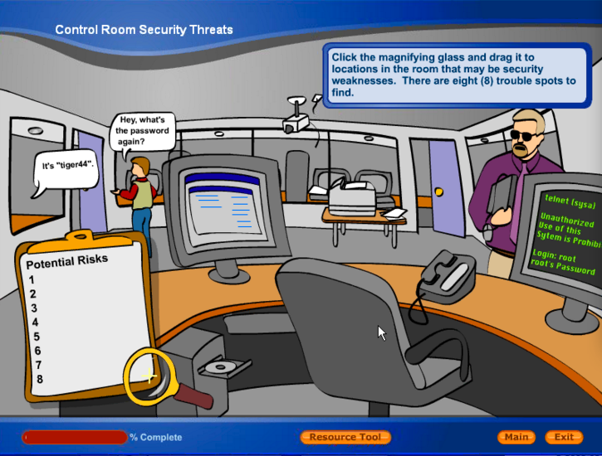

Notes:
This illustration creates an immersive environment where learners inductively discover threats
—a scavenger hunt

Slide 13
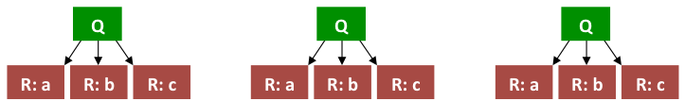
Q
R: a
R: b
R: c
Q
Q
Q
R: a
R: b
R: c
R: a
R: b
R: c
R: a
R: b
R: c
Difficulty:
Branched interactions proliferate geometrically.
[18]
[54]
[162]…
Notes:
In a branching scenario, decisions that are made affect the choices that are available later.
It is more like real life where you can recover from mistakes in through a series of decisions.

Slide 14
Q
R: a
R: b
R: c
Q
Q
Q
R: a
R: b
R: c
R: a
R: b
R: c
R: a
R: b
R: c
[18]
[54]
[162]…

Slide 15
Q
R: a
R: b
R: c
Q
Q
Q
R: a
R: b
R: c
R: a
R: b
R: c
R: a
R: b
R: c
[27]
[81]
[243]…

Slide 16
Q
R: a
R: b
R: c
Q
Q
Q
R: a
R: b
R: c
R: a
R: b
R: c
R: a
R: b
R: c
[Back to start]

Slide 17
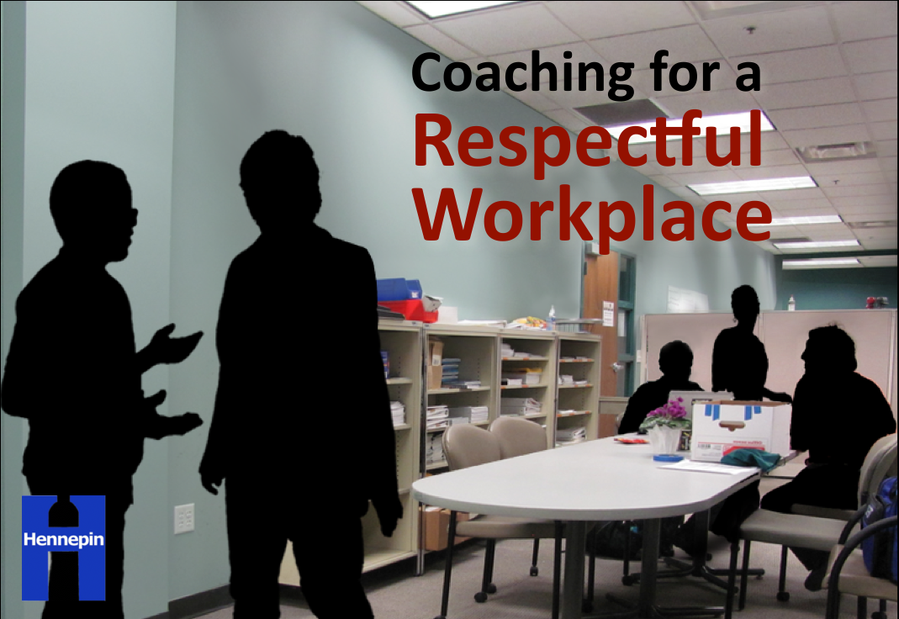

Coaching for a Respectful
Workplace

Slide 18
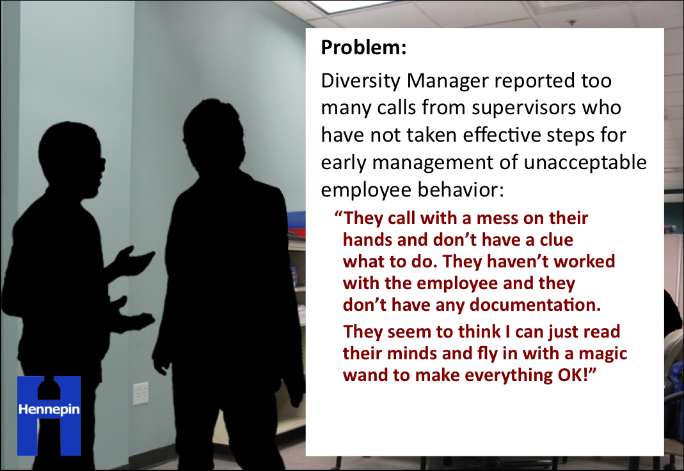
Coaching for a Respectful
Workplace
Problem:
Diversity Manager reported too many calls from supervisors who have not taken effective steps for early management of unacceptable employee behavior:
“They call with a mess on their
hands and don’t have a clue
what to do. They haven’t worked with the employee and they
don’t have any documentation.
They seem to think I can just read their minds and fly in with a magic wand to make everything OK!”
Notes:
Instead of working with the employee, they call.
and they don’t have any documentation.
They seem to think Diversity Manager can fix everything.

Slide 19
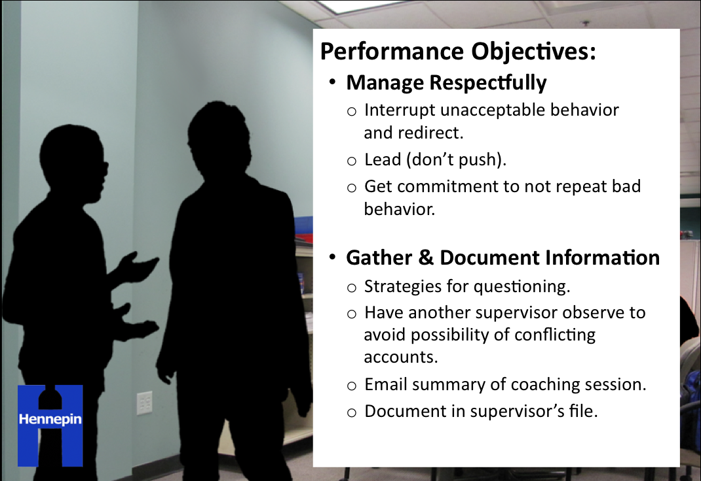
Coaching for a Respectful
Workplace
Performance Objectives:
Manage Respectfully
  Interrupt unacceptable behavior
  and redirect.
  Lead (don’t push).
  Get commitment to not repeat bad behavior.
Gather & Document Information
  Strategies for questioning.
  Have another supervisor observe to avoid possibility of conflicting accounts.
  Email summary of coaching session.
  Document in supervisor’s file.
Notes:
Worked with SMEs that included the Diversity Manager, HR Generalists, OD, 3 supervisors to arrive at performance objectives.
Lead (don’t push):
A light, but firm approach is more effective in getting cooperation than a heavy one
Affirm respect for the persons you are coaching—avoid appearing paternalistic or condescending
Avoid any appearance of favoritism in conflicts
Do as much as you can before bringing in help from outside your unit
Stop small problems before they grow into large ones
Manage gossip that may feed a bad situation
Show example

Slide 20
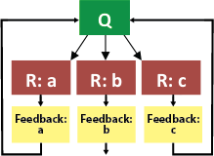

Slide 21



Managing Emotional Barriers to a Productive Workplace
Notes:
How to manage employees that may be experiencing emotional challenges.

Slide 22
Managing Emotional Barriers to a Productive Workplace
Business Results:
Reduce health and behavior issues that affect performance.
Reduce health claims and prescriptions.
Reduce lost work: quicker return to work, absenteeism, ‘presenteeism,’ sick leave, PTO, LTD.
Save disability, administrative costs.
Enhanced supervisor leadership and accountability.
Notes:
How to manage employees that may be experiencing emotional challenges.

Slide 23
Performance Objectives:
Recognize performance issues that may
be the result of emotional distress.
Gather information non-judgmentally.
Reinforce Job Expectations.
Suggest resources (providers).
Collaborate on Action Plan.
Document.
Follow up.
Notes:
New patterns of negative behavior:
Lateness or absence
Missing deadlines or drop in productivity
Not participating in regular activities
Drop in quality of work
Long breaks, long personal phone calls, or distraction
Irritability, short with co-workers, clients
Inattention or forgetfulness
Single instances of abrupt or extreme behavior
Show examples 1 & 2

Slide 24
First Prototype Flow
1) Start
2) Chuck is late again.
How open?
a) “Lateness must stop.” (3)
b) “I’ve noticed…” (5)
3) Chuck: “I’ll take care of it.”
You:
a) “See that you do, OK?” (4)
b) “What do differently?” (6)
5) Chuck: “Things complex”
You:
a) “What do differently?” (6)
b) “Tell me about it?” (7)
4) Chuck: “I will.”
Consider; return to 2.
6) Chuck: “Alarm earlier”
Consider; return to 2.
7) Chuck: “Hard time sleeping.”
You:
a) “I use Ambien.” (8)
b) ”County has resources.” (9)
8) Chuck: “Figure out something…”
Consider; return to 7.
9) Chuck: “Like what?”
You:
a) “Start with EAP.”
b) “HR website.”
10) Chuck: “I’ll try that.”
You:
a) “Check in Tuesday.”
b) “Let me know...”
11) Chuck: “OK, thanks…”
Consider..

Slide 25
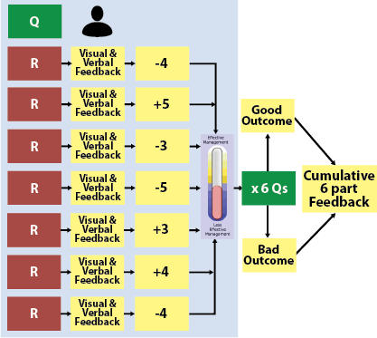
Managing Emotional Barriers Flow

Slide 26
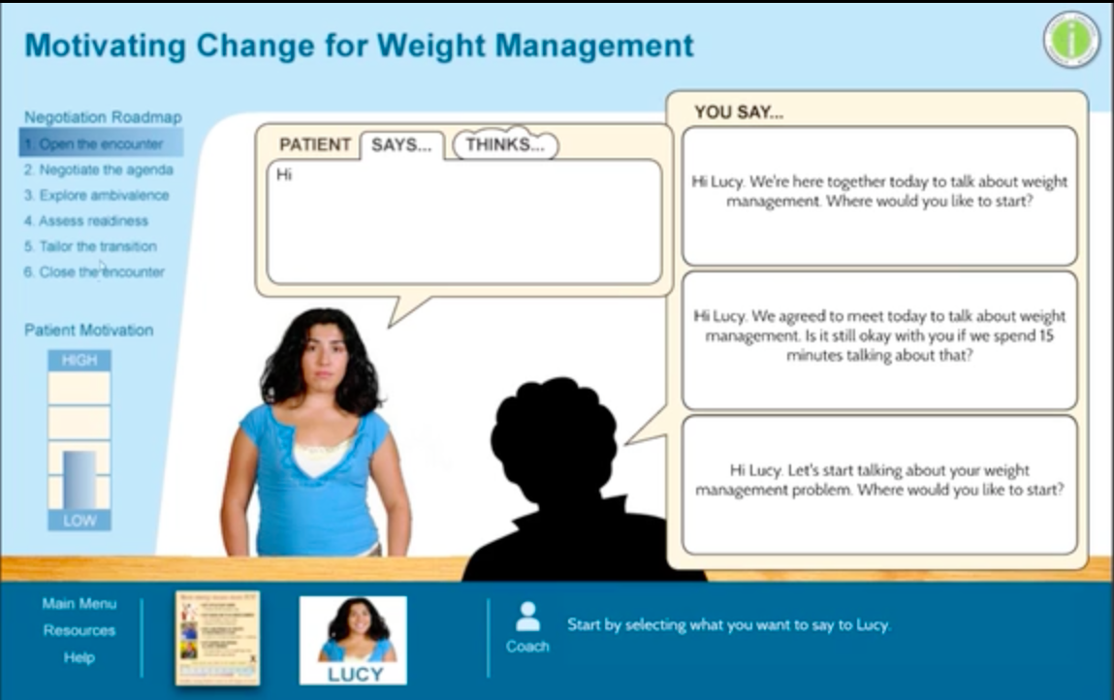

Slide 27
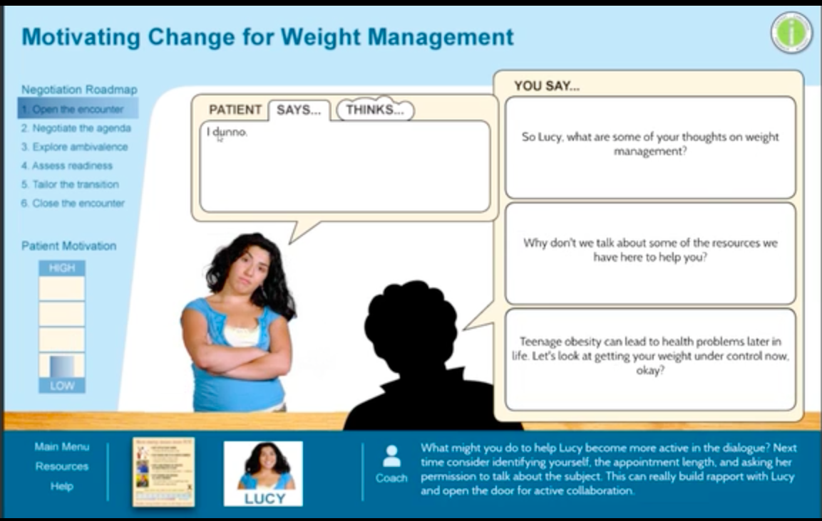

Slide 28
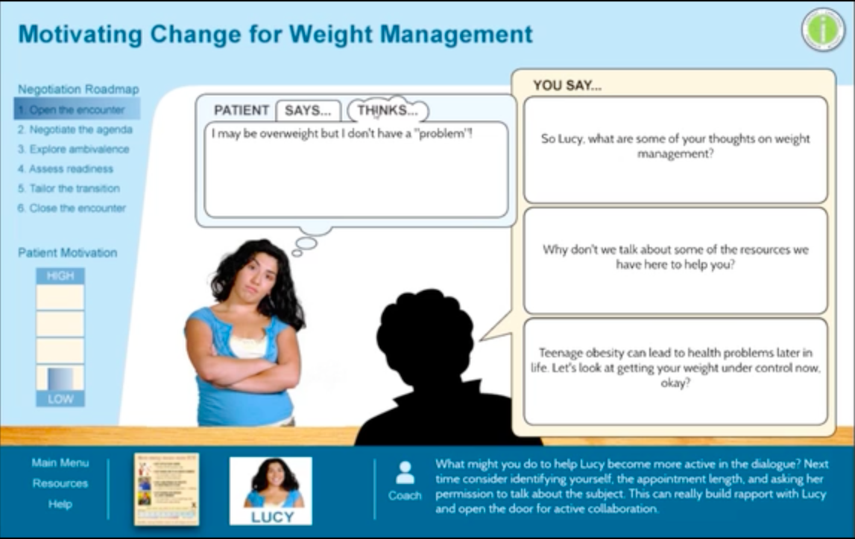

Slide 29
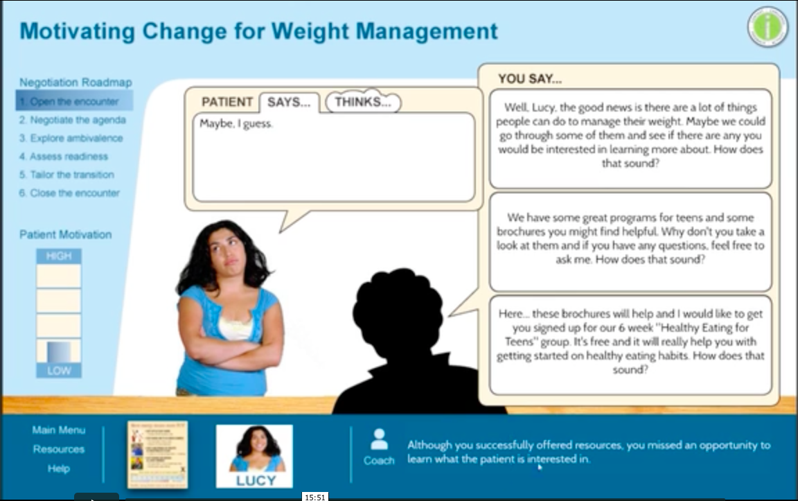

Slide 30
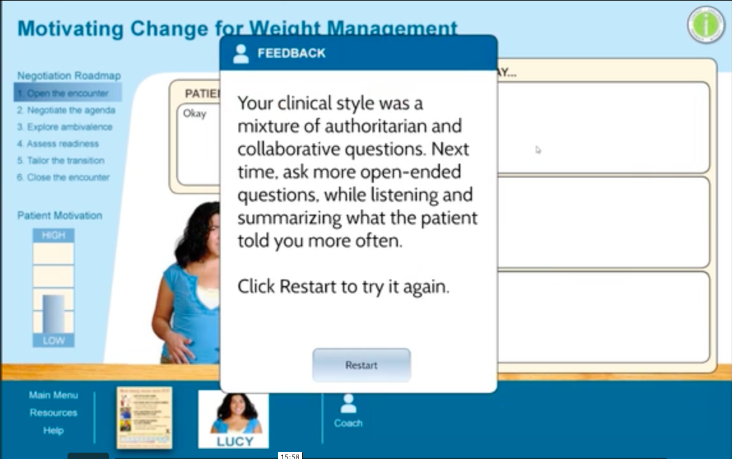

Slide 31
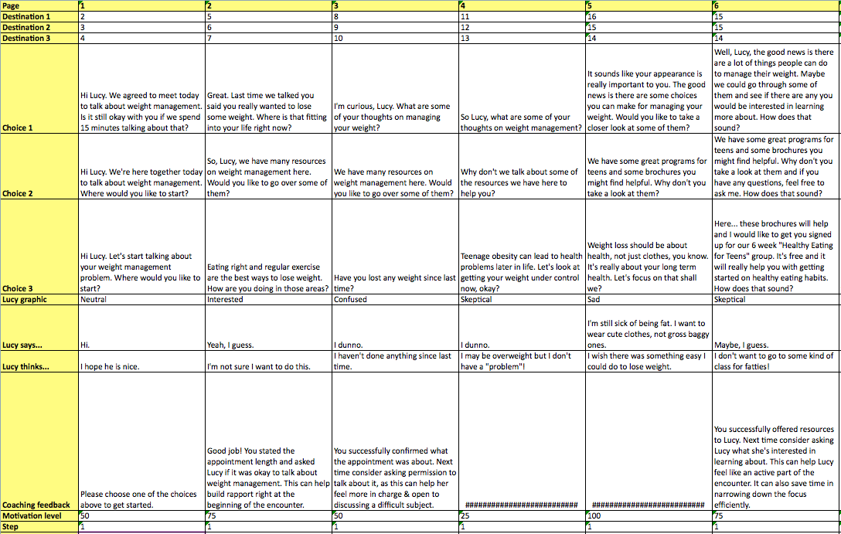

Slide 32
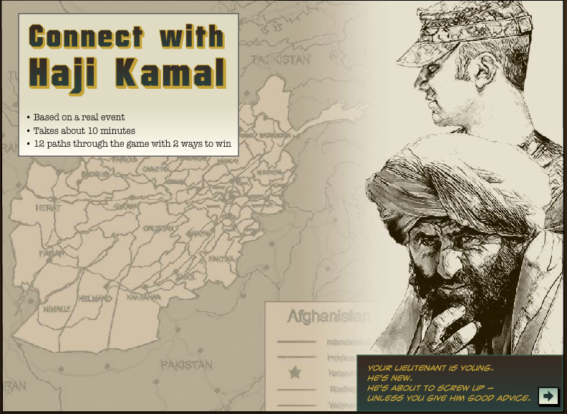
See it at: cathy-moore.com

Slide 33
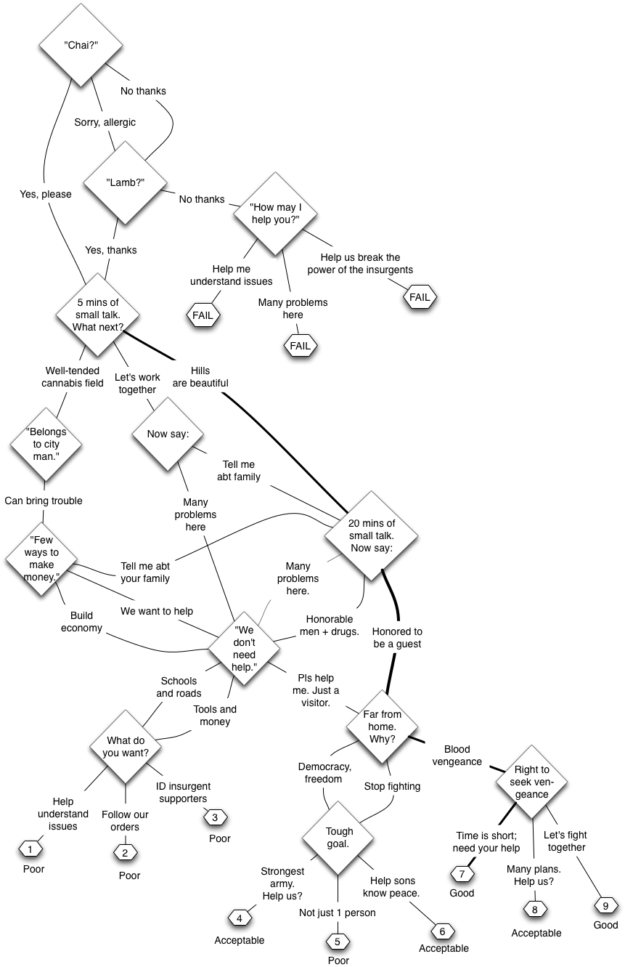
Haji Kamal’s Flow:

Slide 34
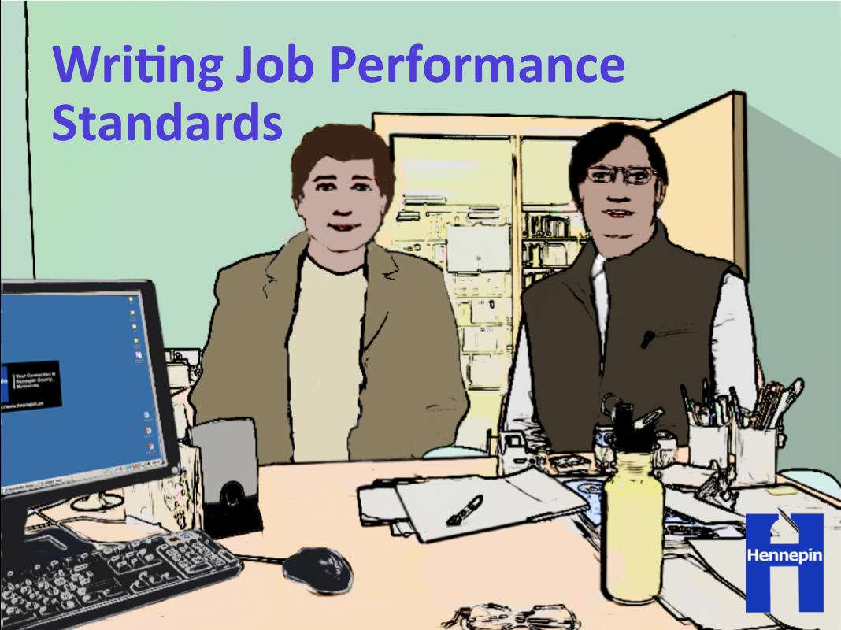

Slide 35
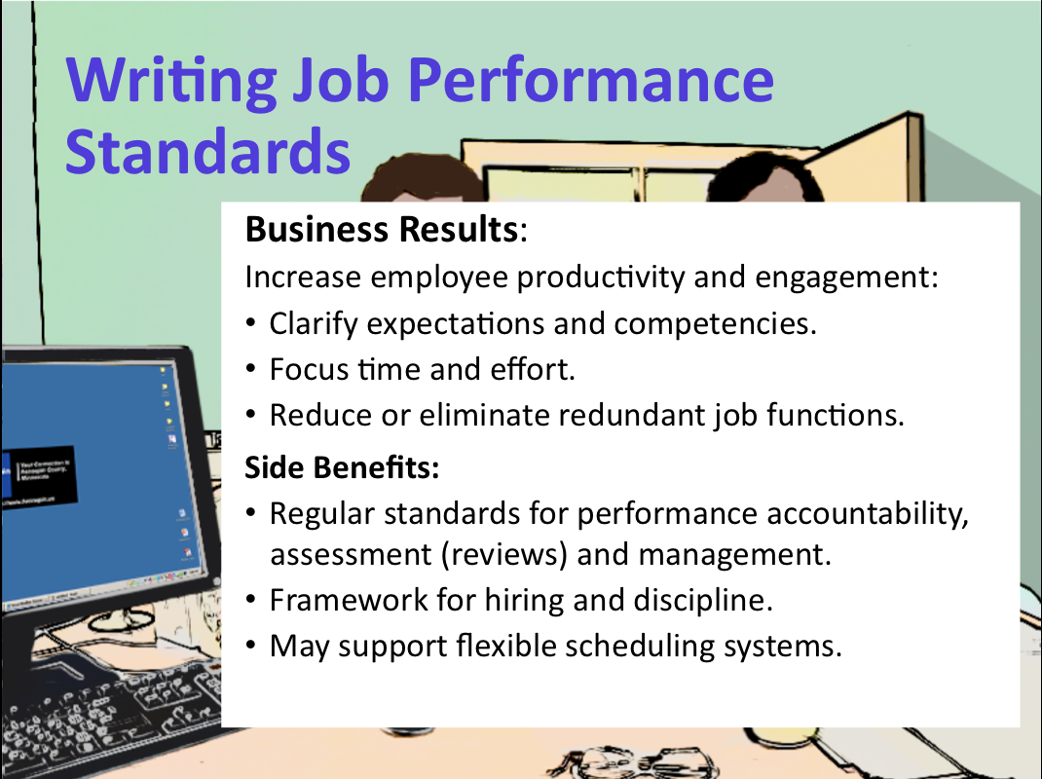

Slide 36
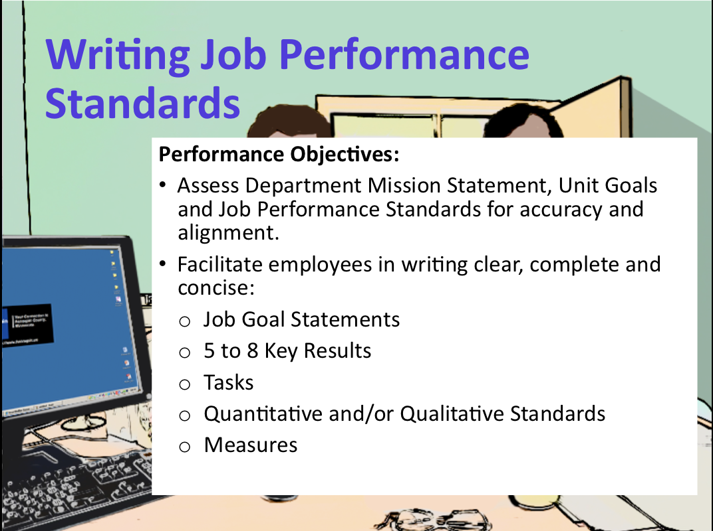

Slide 37

David Amdur
amdur@usgo.net
Notes:
Scenarios-based learning promote learning transfer
by presenting the learner with realistic situations
in which they practice making decisions and experience the results.

