Slide 1
Accessibility:
How does it impact you?
Jay Wyant, MN CIAO
Digital Learning Forum
November 11, 2013

Slide 2
Objectives
Understand the basics of EIT accessibility, with a focus on multimedia and documents
Articulate the value propositions of accessible e-learning programs
Identify key strategies and best practices for creating accessible
e-learning materials

Slide 3

Who Are You?
Website/application developer
Instructional designer
Content creator/writer
Graphic designer
Animations creator
Media/video producer
All of the above
Other?
Notes:
Windows vs Mac?
IE/Chrome/Firefox/other?

Slide 4
The Office of Accessibility
2009 law
Advisory Committee & work groups
2011 recommendations to legislature
State Accessibility Standard

Slide 5
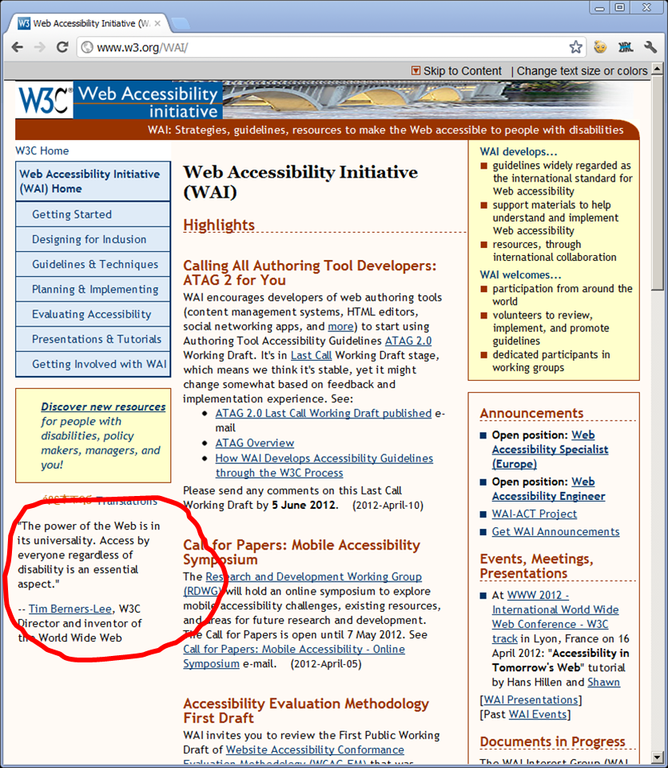
Accessibility quote by Tim Berners-Lee
“The power of the Web
is in its universality.
Access by everyone
regardless of disability
is an essential aspect.”
-- Tim Berners-Lee
W3C Director and inventor
of the World Wide Web

Slide 6

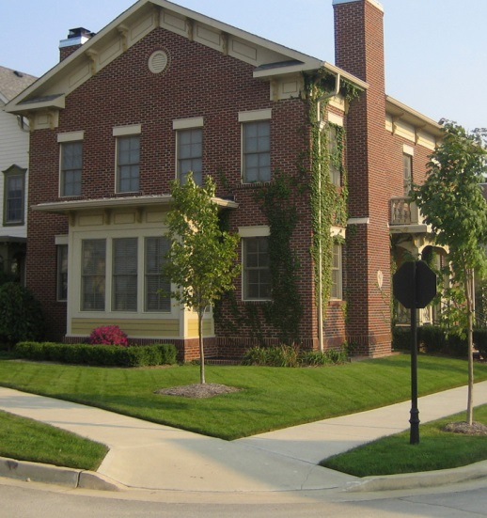

Accessibility Quick Quiz
What is Accessibility?
What is Accommodation?
What is Assistive Technology (AT)?
Notes:
Distinguish between (IT) accessibility and accommodation.
Accessibility is built in, for everyone to use; technology centered, not person centered; proactive.
Some call it an “electronic curb cut”
“curb cut” links to video:
http://www.state.mn.us/mn/forms/oetweb/accessibility/curb-cut-video/Accessibility_Video_Large.html

Slide 7
Accessibility Terminology
ADA compatible
508 compliant
Screen-reader friendly
“Certified Organic”?
Notes:
Buzzwords vs what you want to mean

Slide 8

Accessibility Laws and Standards
MN Statutes
    MN 2009 law (chapter131)
    2013 statutes: 363A.42 (Public Records) and 363A.43 (Cont’ Ed)
State Standard
    Section 508
    WCAG 2.0
Federal
    ADA (Title II)
Notes:
The federal and state laws lean heavily on standards developed by independent bodies, most notably WCAG 2.0, developed by W3C committee.
How familiar is the audience with ADA?
Section 508 is currently going through a “refresh” process.
MN’s standards reference both section 508 and the WCAG 2.0
New law 363A.42/43 took effect Jan 1 2013.
Note if any receive state or fed funds - *may* need to comply
Note role of ADA (Title 2) and CVAA (comm & video accessibility)

Slide 9
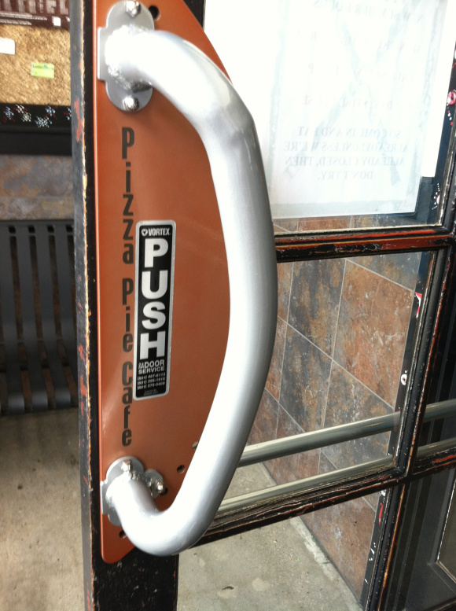
Discussion Question
How is usability different than accessibility?
Notes:
Webster defines accessibility as "capable of being reached," and it defines usability as "capable of being used."
Just complying with accessibility doesn’t mean you have made your site/service useful.
With older folks, who may be even less familiar with technology, there’s an even higher premium on usability. See popularity of simple cell phones with gigantic number pads.
Phone from just5.com

Slide 10


Interactivity Considerations
Notes:
What are your expectations? How will the user activate controls? Keyboard vs. Mouse…
TV: http://www.childpsych.co.za/barriers-to-learning/rid-tv-kids-sake/
Serena: http://www.telegraph.co.uk/sport/tennis/wimbledon/10148431/Wimbledon-2013-Serena-Williams-could-only-beat-men-ranked-in-the-300s-not-Andy-Murray-says-Jeff-Tarango.html

Slide 11
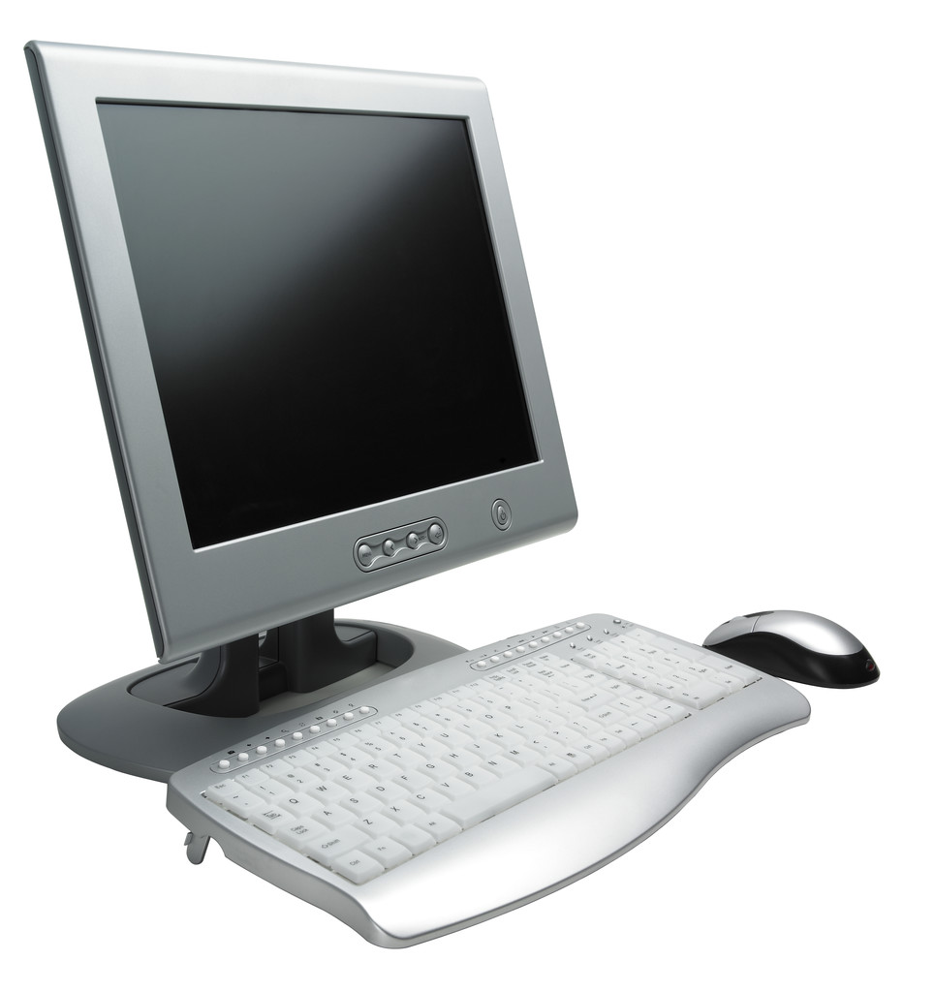
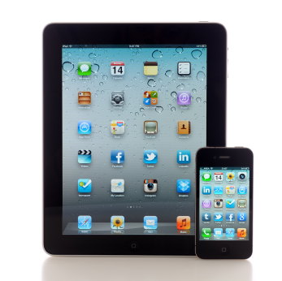
Technology Considerations
Notes:
More to the point – can you exclude any of these in your product specs?
Flash-based programs, for example – any customers with iPads?
Ask if folks are aware of the accessibility settings on phones
Desktop computer: Dell.com website
iPads: Apple website

Slide 12


Demo: Screen Reader
Screen readers not same as text-to-speech
Most popular readers:
  Freedom Scientific’s JAWS
  NVDA
Demo: http://www.youtube.com/watch?v=l6Jjn8DPWkY

Slide 13
Issues to Watch For
Interface: how does the user manipulate the resources?
Content: ordering and markup
Multimedia: captioning and audio description
Project management: accounting for time and costs

Slide 14
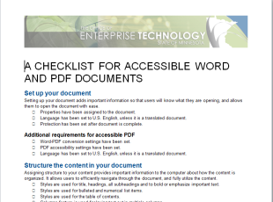


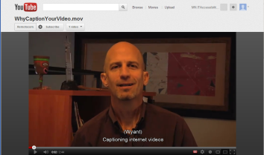
Case Studies
Website/Interface Accessibility
Document Accessibility
Media Accessibility
Advance to Summary

Slide 15
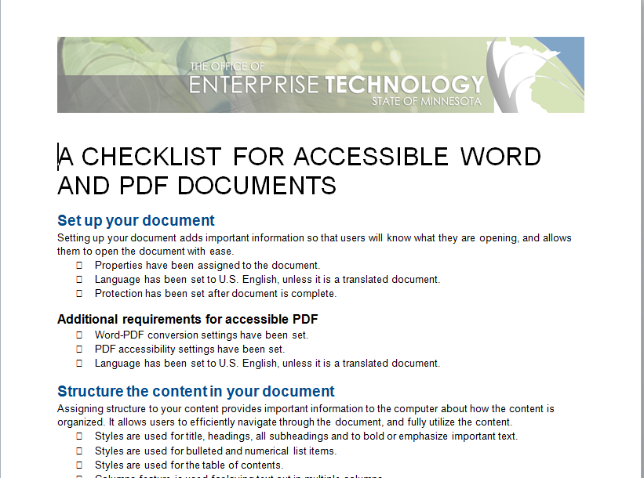
Case Study: Document Accessibility
OS
MS Office
PDF/Adobe Acrobat

Slide 16
“Top 5” Tips for Word Documents
Use heading styles
Use Alt Text
Avoid text boxes and tables for layout
Give hyperlinks meaningful names
Don’t rely on color to convey meaning
Notes:
Open CIAO strategic plan. Toggle different styles.
Move on to next pages to cover remaining bullets

Slide 17
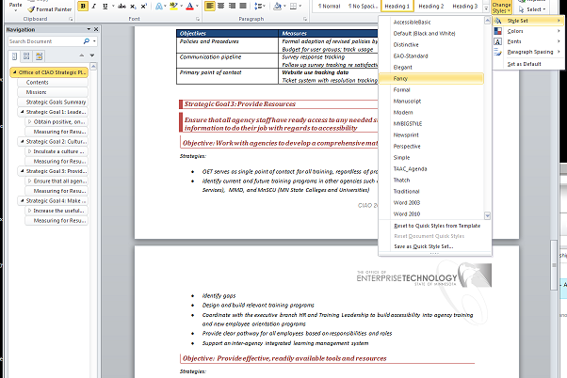
Sample of Word document styles

Slide 18
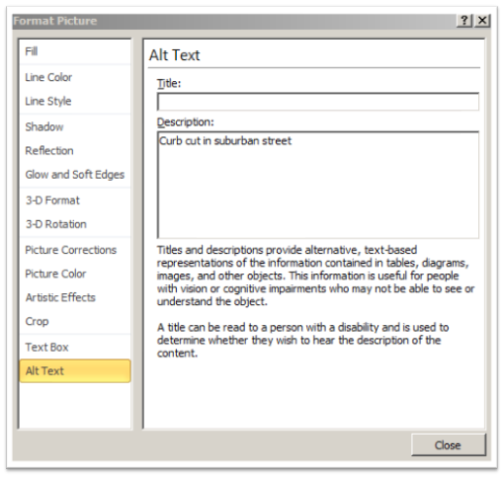
Alt Text
Notes:
Jay
Right-click diagram. Select last option: “Format Picture” (or “format object when working with a grouping). Select last option: “Alt Text.”
NOTE: The title field will not be saved as alternative text when a file is saved as HTML.

Slide 19
Text Boxes & Tables
Text boxes are not accessible
Tables are for data organization only
Use columns feature instead of table to flow text

Slide 20
Meaningful Hyperlinks
Click here for best practices on creating purposeful hyperlinks
Best practices on creating purposeful hyperlinks
Clearly demonstrate what the link will do, such as when going to a form (opens in new tab)
Indicate document type (PDF) (Word)

Slide 21
Example: Color Treatments
Widget | Square | Long | Active
Safe | Yes | No | X
Extreme | Yes | No | X
Dangerous | No | Yes | X
Deadly | No | Yes | O
Notes:
Do not rely on color alone. Use shapes, patterns, and/or text to help differentiate elements.

Slide 22
Example: Pattern Treatments (Bar)
Notes:
Think about whether you can print the document in b&w

Slide 23
Example: Pattern Treatments (Pie)
Notes:
Again, supports b&w printing

Slide 24
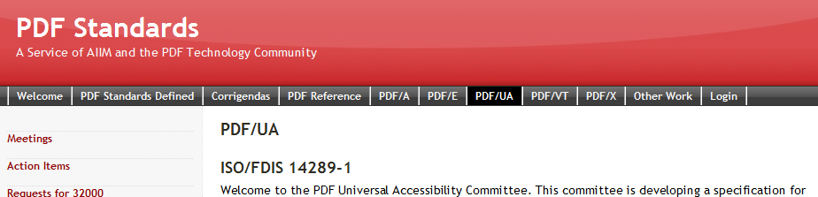
PDF Conversion
Adobe Acrobat 9, X, or XI
  Must have Pro or Suite version
  Conversion vs. testing
  Clean originating doc is best
  Word vs. other file formats
Who should do it?
Notes:
Emphasize the value of a “ninja”
As noted earlier, avoid creating pdfs as a matter of course. Ask: why should the document be a PDF? What is the reason for choosing PDF over other formats?

Slide 25
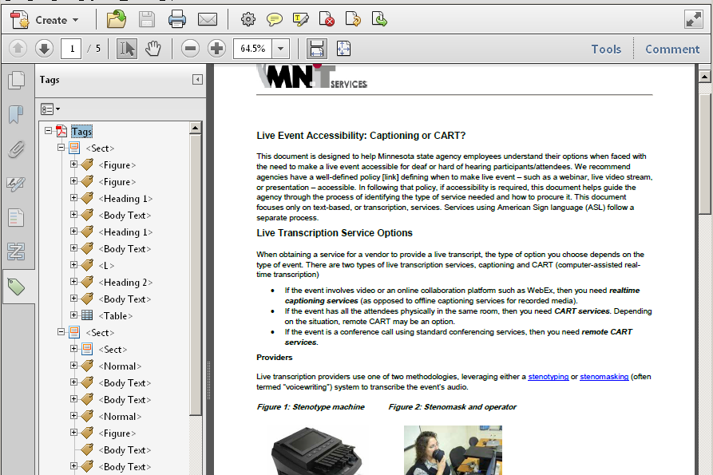
A Look at the Innards of a PDF

Slide 26

Case Study:
Web Sites & Interfaces

Slide 27
Current trends: accessible web development
WAI-ARIA
Responsive design
Iterative testing during development
Testing tools and resources

Slide 28

Key Issues for User Interaction
Navigation
Mouse & keyboard issues
Images and non-text elements
Forms
Notes:
Reference MN.IT site: http://mn.gov/oet/governance/for-agencies/accessibility/websites_applications.jsp#
Notably Development/Testing tab

Slide 29
Navigation and links
Consistent navigation (predictable)
Skip to content
Clear pathways (breadcrumb)
Meaningful link text that conveys purpose

Slide 30
Mouse and keyboard issues
Test with keyboard only
Focus: visible and orderly
Do not rely upon mouse clicks
Avoid tedious clicking issues (pick lists, menus)
Notes:
Sometimes the meaningful sequence is obvious visually, but the tab order does not reflect this.
Examples of navigation and keyboard operation (compare IE and Chrome/Firefox):
http://www.cdc.gov/training/ACP/page32982.html
http://www.mncdhh.org/makingyourcase/started_stayingsafe.html

Slide 31
Images and non-text elements
ALT tags for informative images (non-decorative)
Link to descriptions for longer text blocks
Decorative images presented with CSS (not in content)
Contrast ratio between background and text
Notes:
Contrast tools (demo on mn.gov) goal is 4.5:1 or 3:1 for large text:
Colour contrast
Chrome contrast plugin

Slide 32
Forms
Label tags for ALL input points
Correct tab sequence
Access keys for complex, long and laborious forms that are used frequently
Navigable and able to submit with keyboard
Notes:
Use Firefox: ssa.gov

Slide 33
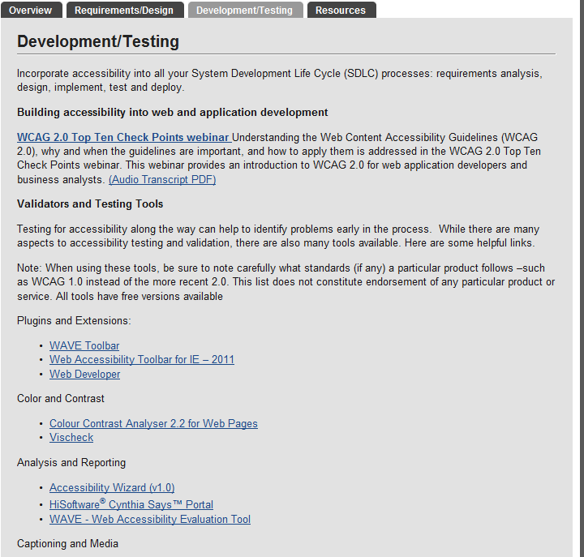
Testing for accessibility

Slide 34
Test Early and Test Often
Keyboard testing
WAVE and WAT Toolbars
Color contrast tools

Slide 35
Transition page
Back to case study list
Advance to summary

Slide 36

Case Study: Media Accessibility
Notes:
Ask: How pervasive are webinars, particularly in outstate Minnesota? How about telehealth?

Slide 37
Requirements
Video
  Audio description (prerecorded)
  Captioning (prerecorded and live)
    Captions vs. Subtitles
Audio
  Text Transcript
Accessible user interfaces and controls
Notes:
Source: http://www.w3.org/TR/WCAG20/, Guideline 1.2
Links are to http://captionmax.com/services/style-gallery/, “Description” and “Custom Subtitles”

Slide 38
Strategies: Video
Purpose
  Why a video?
  What’s the information?
Planning
  Scripting: include descriptions of key visuals
  Speaker instructions: describe visual’s message
  How will you visually represent the audio?
Execution
  Time frame for all processes
  Budget

Slide 39
Issues and Tools/Resources
To YouTube or Not?
  Auto time stamping a transcript
  Alternative tools: webcaptioning.com
In-house vs. hiring a pro
  Best practices: DCMP
Live vs. recorded captioning
  Live: CART or captioning?
User interface
  Caption toggle
  Description toggle (or separate video)
  Accessible controls
Notes:
General DCMP info for vendors re captioning and description: http://www.dcmp.org/vendor-info
Description key: http://www.dcmp.org/descriptionkey/index.html
Captioning key: http://captioningkey.org/

Slide 40

Make accessibility part of the solution
Back to case study list
Advance to summary
Notes:
http://www.virginamerica.com/vx/safetyvideo?int=hp_module_02_safetyVideo_131029

Slide 41
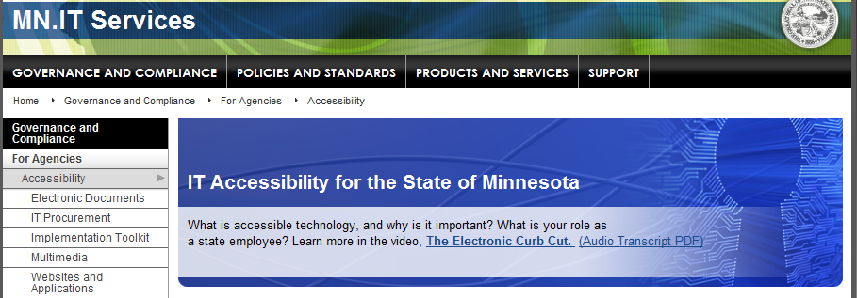
MN.IT Office of Accessibility
Outreach/awareness
Policies/procedures
Training
Purchasing
Support services
Tools and resources
Notes:
Emphasize One-Stop Shop
We’re a national leader – USDA, Ottawa, Alaska has asked about using/linking to our materials.
Collaboration with other states, fed agencies

Slide 42
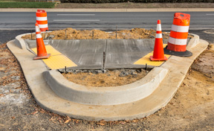
Accessibility is Infrastructure
Avoid add-ons
Culture shock
Reduce long-term costs
Notes:
Curb cuts work when they are built as part of the sidewalk building process
Communication and training are key to change
So is having access to the right resources

Slide 43
Build accessibility into processes
Design & Development
  Websites & Applications
Content Creation
  Word, PowerPoint and PDF Documents
  Video, Webcasts, Podcasts and Multimedia
Systems
  Processes
  Workflow

Slide 44
Questions?

Slide 45
Thank You!
Jay Wyant
jay.wyant@state.mn.us

Slide 46
Notes for update
Draw parallels between “508 compliant” and “ADA compliant” and that of “Certified Organic.”
Include examples of descriptive narration & captioning and when to use them: Carole, bagleyca@comcast.net and Robb Jacobs: DCMP
Accessible interfaces: pc/mac and tablets (captioning essentials? CDC?
Add usability image – door handle
Talk about testing, notably via keyboard, no audio, etc. as well as tools such as WAVE.
Demo adaptive tech – why tiny radio buttons can be a problem
Switch – light switch analogy – turns on/off whatever it is plugged into – mouse, or a particular mouse function such as scroll, or something else
http://www.cameramouse.org/

Slide 47
Some potential ‘specifics’ that came back from them;
Everyone in this group has had experience creating online learning modules or courses, so they face the 508 law regularly. You may not be able to cite or show specific examples of ‘good’ online course that are compliant, but examples and solutions to meeting the challenge of creating 508 compliant eLearning, would be a great topic & discussion.
Another area would be some definition, examples and lively discussion on the follow: what is in the section 508 law? What is the purpose for Descriptive Narration? What is Closed Captioning? Also, should there be waivers for accessibility?
One aspect that they have NOT seen is the adaptive technology that you brought to our April session in St. Cloud. Obviously seeing someone demo. these tools, as you did for our group, would be very useful & interesting to the DLF audience.

