Slide 1
Assessment Tools for K-12 and Corporate L&D
Digital Learning Forum
February 12, 2018
Presented by: Sue Mehrkens
K-12 Info Provided by: Patricia Leonard
and Carole Bagley, Ph.D.
Notes:
Note: This presentation includes numerous website links. View in Slide Show mode to activate the links.

Slide 2
Topics
K-12 Education (Patricia Leonard)
What is formative assessment and how can you make it more effective.
Why use formative assessment.
A variety of assessment tools.
Corporate L&D (Sue Mehrkens)
The importance of an overall assessment strategy.
Formative and culminating assessment methods that meet your objectives.
Assessment best practices.
Assessment tools used in corporate settings.

Slide 3
Assessment Defined
In education, the term assessment refers to the wide variety of methods or tools that educators use to evaluate, measure, and document the academic readiness, learning progress, skill acquisition, or educational needs of students.
In L&D, the term assessment refers to the wide variety of methods or tools that training professionals use to evaluate, measure, and document the academic readiness, learning progress, skill acquisition, or educational needs of employees.
Notes:
Assessments can be used throughout the educational experience. For example:
Pre-hire
Pretests
Post-tests (finals)
Practical Exams (hands-on)
Test-Outs
Differences Tests (for minor software upgrades)
Competency Tests

Slide 4
Formative vs. Summative
Formative Assessment | Summative Assessment
Provides intermittent feedback which influences learning. Effective feedback includes what he/she did well and what he/she needs improvement on. Usually does not impact the final score/grade. | Used to quantify achievement in relation to the learning objectives. Typically used at the end of a module, session or course. Can serve as a “gate” or “hurdle” before moving on. Test validity and reliability are very important. Usually impacts the final score/grade so has more diagnostic value.
Notes:
For summative assessments, security (controlled access) and ethical behavior by test takers is very important.

Slide 5
The Power of Formative Assessments
There is strong evidence and consensus that the formative assessment process used by teachers and students during instruction has very powerful and positive effects on student achievement. On the other hand, there is little evidence that externally imposed high-stake tests have improved school quality or reduced achievement score gaps.
~ Amy Hamborg
Notes:
Note: This information was provided by Patricia Leonard (added after the presentation).

Slide 6
K-12 Assessment Tools
Socrative (www.masteryconnect.com/socrative)
Socrative is a freemium, instant-response tool which may be used for formative assessments.
Teachers can easily create quizzes, on-the-fly questions, an assessment game and exit tickets (checking for understanding before children leave the classroom).
Socrative supports short answer, multiple choice and true/false questions from any device.
Socrative Free classroom is 50 students.
Class sizes >50 requires the Socrative PRO classroom version.
Formative (www.goformative.com)
Formative is an assessment tool where students can type, draw, or submit images to demonstrate their understanding.
Teachers can see what students know or are thinking on any topic or subject in real time.
Teachers may create their own assessments or borrow from a shared library.
Assessments can be set up for auto grading and teachers can provide direct student feedback to any question.
Notes:
Note: This information was provided by Patricia Leonard (added after the presentation).

Slide 7
K-12 Assessment Tools
Kaizena (www.Kaizena.com)
Provides feedback on student writing.
Allows teacher to view a student’s document and leave feedback.
Will alert teacher when students respond to your comments.
Google Forms for Assessment
Allows students to create powerful, clean-looking online information and gather data online.
Part of the G-Suite.
Flubaroo
A free add-on to Google Forms/Sheets which lets teachers grade and analyze student performance on multiple choice and fill-in assignments.
Notes:
Note: This information was provided by Patricia Leonard (added after the presentation).

Slide 8
ADDIE Model
Analysis
Design
Development
Implementation
Evaluation (Assessment)
Notes:
Although most people are familiar with the ADDIE model, the first and last steps are often skipped
You need to conduct some Needs Analysis to determine what the best learning solution is. After all, it may not be training at all!
How do you know if you “hit the mark” if you skip Evaluation? Assessment/Evaluation is very important.
These are the “bookends” to a solid design no matter what model you use.

Slide 9
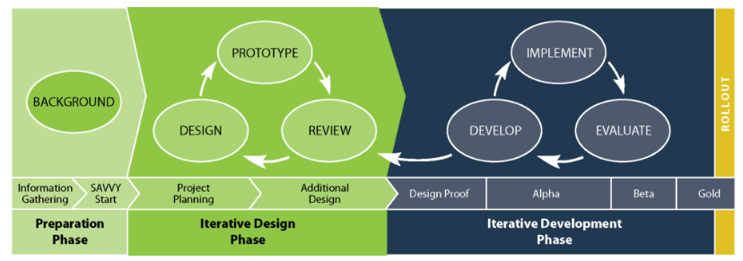
Successive Approximation Model (SAM)
Notes:
SAM is an Agile Instructional Systems Design model that has been introduced as an alternative to ADDIE that also emphasizes collaboration, efficiency and repetition.

Slide 10
Kirkpatrick’s Levels of Evaluation
4. Results
3. Behavior
2. Learning
1. Reaction
Notes:
Smile sheet – simple evaluations.
Monitor post-training feedback
What did they learn by attending
What can they apply to their jobs
On-the-job application of new skills/knowledge
Outcomes that you or your organization have determined are good for business, good for the employees, or good for the bottom line.
Review training impact by observing on-the-job application.
Obtain input from instructors, participants and their managers through follow-up surveys

Slide 11
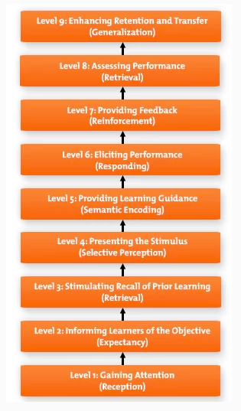
Gagne's Nine Levels of Learning

Slide 12
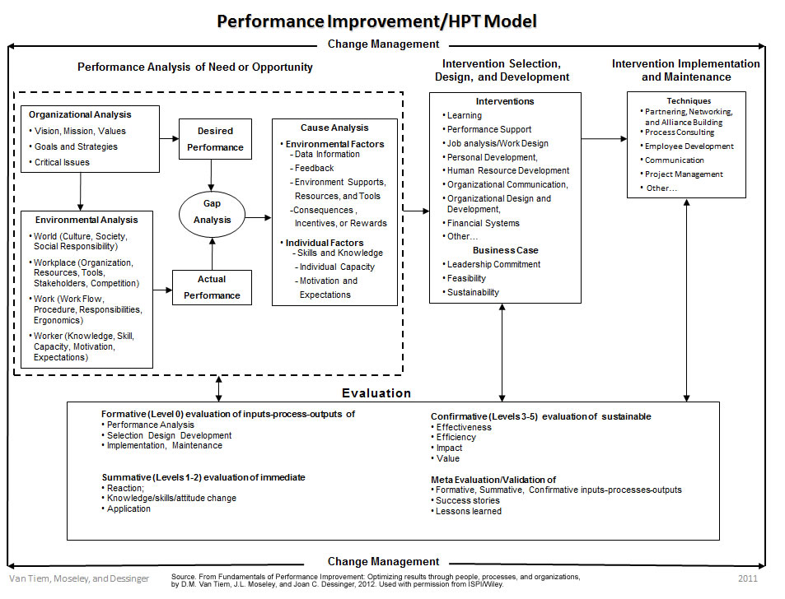
www.ispi.org
Notes:
No matter what model you use to design/develop training solutions, evaluation (or assessment) is a KEY component.

Slide 13
Overall Assessment Tasks
Align assessment strategy with organizational goals, objectives and culture.
Begin…with the end in mind.
Focus on end results/key outcomes.
Assess ongoing management support of training goals.
Plan what you want to measure and why.
Decide on the types of assessment (how).
Consider documenting your process.
Keep it simple for others.
Notes:
KISS - If it is too complex, they won’t do it
Briefly show people the Assessment Process and LMS flowcharts I created at HON.

Slide 14
Manage Data
Leverage existing data.
Successful completion of e-learning modules, time spent, ILTs, post-training assessments, etc.
Collect, analyze & summarize data in phases.
Look for trends.
Explain the implications of the data.
Avoid “information overload.”
Track significant questions, prioritize issues and evaluate results to key goals or stakeholder expectations.
Adjust assessment strategy as needed over time.
Notes:
Track ?s (Capella HUB example)
People tend to pay attention to what gets measured.

Slide 15
Assessment Best Practices
Tie each question to a learning objective.
Maintain a consistent look/feel for all tests.
Use multiple choice, true/false and yes/no questions.
Minimize the use of matching, fill-in-the-blank, hotspot and drag & drop.
Time tests - People tend to perform better.
Design to accommodate the minimum requirements.
Use consistent scoring and grading scale.
Limit the number of attempts so people don’t “bang of the test.”
Plan for regular reviews (every 6 months).
Notes:
Where tools lead, fools follow
Minimize the use of matching, fill-in-the-blank, hotspot and drag & drop due to accessibility and mobile deployment issues.

Slide 16
Writing Standards (1 of 3)
Start with “Which of the following…”
Clear/concise sentence structure.
Use “active voice.”
Provide instructions first then ask the question.
Tell people where to go and then what to do.
Use the System Configuration icon to access the controller parameters.
Emphasize key words with boldface.
Avoid underlining.
Notes:
Note: These guidelines are based on feedback from Prometric (a professional assessment company).
Writing standards can vary widely within each organization/school.

Slide 17
Writing Standards (2 of 3)
Use homogeneous distractors of similar length.
Use a fairly consistent number of options.
Use positive verbiage.
Avoid no, not, never, neither, etc.
People tend to see these as false
Ask at least one other person to review the test for grammar, consistency, etc.

Slide 18
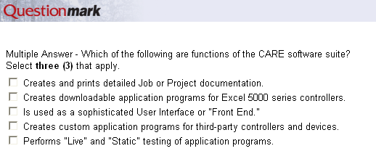
Writing Standards (3 of 3)
For multiple answer, use:
Select X (#) that apply.
Avoid easy options:
Both A & C
All of the above
None of the above

Slide 19
Graphics Standards
Start with “Refer to the following graphic.”
For screenshots, highlight the area of the screen that corresponds with the question.
Helps people focus on the desired information.
Capture images in high resolution.
Import may be better than copy/paste
JPG is often clearer than BMP or PNG.
Crop as needed to avoid scrolling.

Slide 20
Assessment Matrix (1 of 3)
Types | Purpose/Uses | Tools/Examples
Paper-based Tests | Knowledge-based testing (multiple choice, T/F, matching, short-answer, etc.) | ACT Test AP Tests (Physics, Stats…)
Standalone Online Tests | Knowledge-based testing Pretests, Quizzes, Final Exams and Test-outs | ExamBuilder Questionmark Online Quiz Creator (slide 20)
eLearning Knowledge Checks & Tests | Interactivity & check points Knowledge-based testing Software procedures | Articulate Storyline Adobe Captivate
Integrated LMS Tests | Knowledge-based testing Periodic certification or recertification | Cornerstone on Demand Saba SumTotal Comparison
Individual or Group Presentations | Mastery learning Case studies and role plays Communication skills Sales training | Video
Notes:
Since there is not time to demo all of these, we can watch short online descriptions of their capabilities.
Some of these tools are free or offer trial subscriptions for 30 days. Keep in mind that the free apps may have BIG limitations in terms of number of learners, number of questions, etc.

Slide 21
Assessment Matrix (2 of 3)
Types | Purpose/Uses | Tools/Examples
Online Polling & Surveys | General gauge of learning Typically used for ILT or webinars | ARS (slide 21) Kahoot ILT Link Poll Everywhere WebEx Polling SurveyMonkey
Interactive Games | Informal content review | C3SoftWorks Bravo Jeopardy
Hands-on Tests | Knowledge transfer Realistic/reliable predictor of on-the-job success Simulations in “real settings” | CPR training First Aid Emergency Kit LearningSim.com
Competency Tests (or Practicals) | Process/procedural testing Structured observations by field mentors and/or managers Equipment competency | Observational Checklists Keyboarding
Notes:
Poll Everywhere offers a free account – but is limited to 40 respondents
As of 9/16, cost is ~$200/day for more people.
Kahoot is a great tool for ESL learners since it uses shapes and colored answer options.

Slide 22
Assessment Matrix (3 of 3)
Types | Purpose/Uses | Tools/Examples
Career Exploration | To assess career interests | Strong Campbell Interest Inventory Similar Minds
Pre-employment Tests | To confirm candidate qualifications | Capterra
Self-reviews, 360° and Peer Reviews | To gauge learning/perf. Personality profiles To obtain feedback to/from others | Discover Yourself MBTI DiSC Multi-rater 360 Social Styles Inventory StrengthsFinder TalentView Other Self Assessments
Integrated Solutions | Links to your LMS Includes multiple forms of assessments and reporting. | Blackboard Document Editing Metrics that Matter Prometric

Slide 23
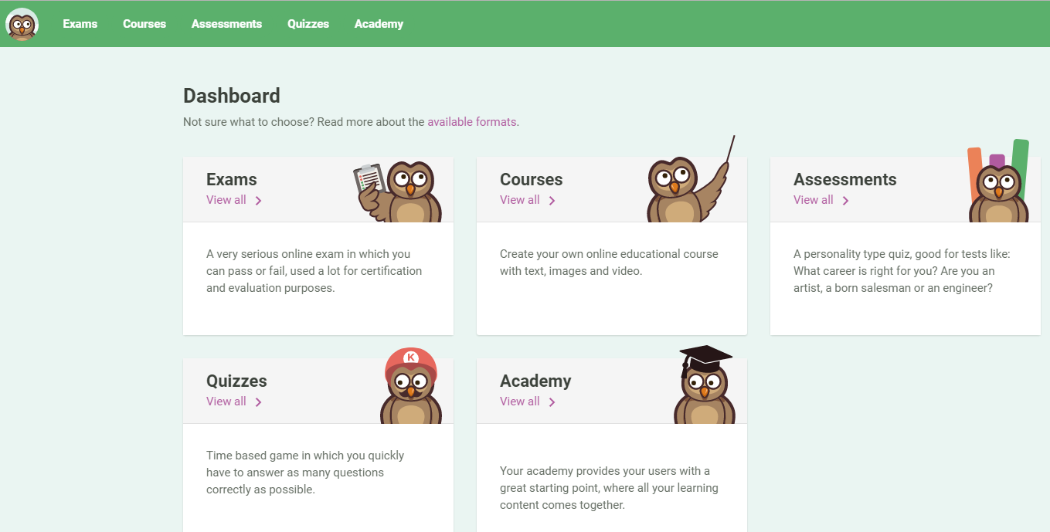
Online Quiz Creator

Slide 24
Audience Response System
Notes:
Turning Technologies equipment was used at a large training session for Medtronic engineers at Earle Brown Center. You can rent the equipment for a session which is less expensive than buying it. This ARS system is fully-integrated with PowerPoint so is a way to build in interactivity and instant feedback on key learning objectives.
Shown here is a sample question to test all of the handheld devices to make sure they work and to make sure everyone knows how to use them to answer questions.

Slide 25
Key Questions Review
Any existing data or prior feedback?
Any key performance factors for success?
Any core issues to resolve?
Are there any critical behaviors that can be observed/measured?
Can we tie assessments to other “drivers” within the organization?
Certifications
Commissions/bonuses
System access
Product access
Restricted area access
Can we consider creating a structured “sign-off” process?
Notes:
Think beyond simple assessments…think of an integrated solution that will put “teeth” into your tests!

Slide 26
Questions/Comments
Contact Information:
Sue Mehrkens
susan.mehrkens@comcast.net
612-719-8191 (cell)

